Slide 1
Agent Framework
Open-source framework for Next-Gen Multi-Agent Solutions

Slide 2
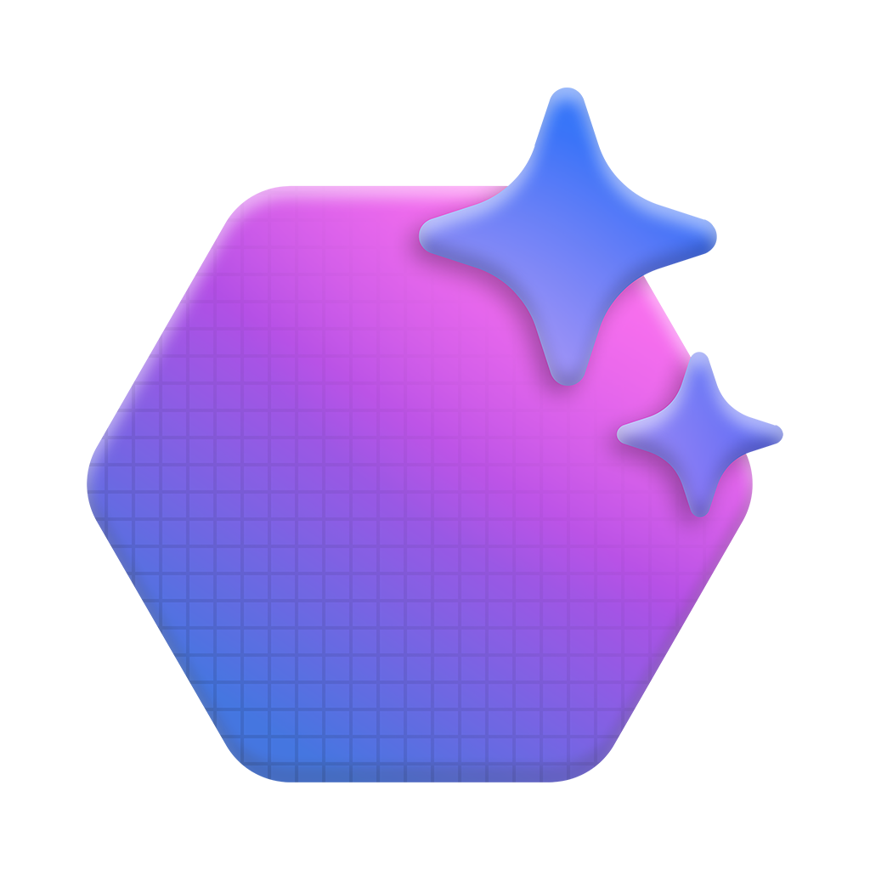





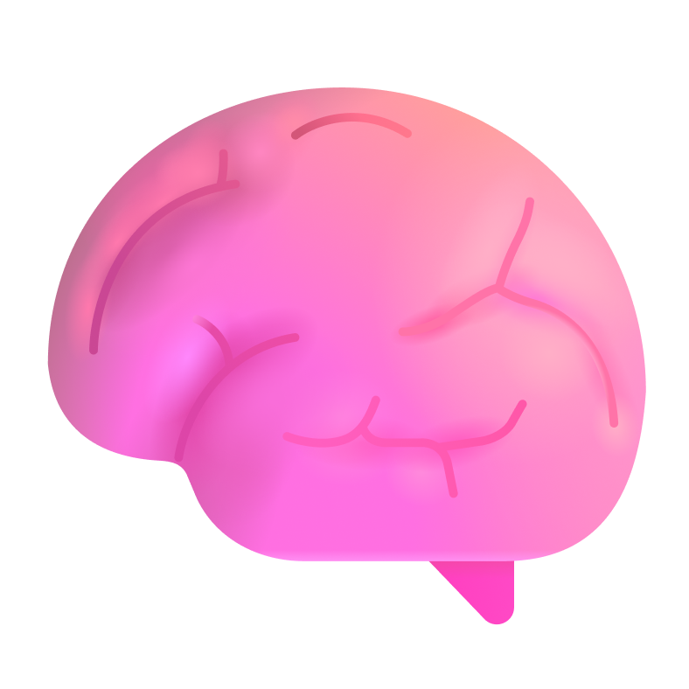
What is an agent?
Agent
LLM
LLM
Input
Output
Instructions
Instructions
Tools
System
events
User
messages
Agent
messages
Tools
Agent
messages
Tool
results
Tool calls
Retrieval
Actions
Memory
Notes:
An AI agent is a simple program where you allow an LLM to help you decide the control flow of the program. It is like a micro-service that can execute tasks and achieve specific business outcomes.
just like microservices, you can update or fine-tune an agent without having to rebuild the whole system. Even if our applications aren’t literally a collection of tiny agents coordinating with each other, thinking in these terms helps us focus on modularity and scalability. It’s all about having a unit of logic that's easy to optimize and improve over time.
What makes an agent different from traditional software (and RPA) is its ability to handle unstructured, multi-modal input, it uses the LLM to decide which tool to invoke.

Slide 3


Unlike previous tools, AI Agent can…
reason,
act and
learn

Slide 4



Why Build Agents in Code?
Full Control & Customization
Local Experimentation
Portability
Code-first agents can use any model, tool, or data source – not limited to pre-defined connectors or templates
Run agents on your laptop with your preferred IDEs (VS Code, GitHub) with no cloud dependency; debug, test, and integrate into CI/CD pipelines before scaling
Move from local to any cloud without rewrites, avoiding vendor lock-in
Notes:
Building AI agents from scratch has traditionally been a complex and challenging task. There are several factors involved, such as integrating diverse tools and APIs that may have different interfaces and data formats. Interoperability is another hurdle, as agents need to work seamlessly across various platforms. Scalability is critical to ensure agents can handle growing data and workloads. Additionally, real-time processing, maintenance, and error handling add to the complexity. These challenges have made it difficult to rapidly deploy and scale AI agents that can be both effective and secure.

Slide 5

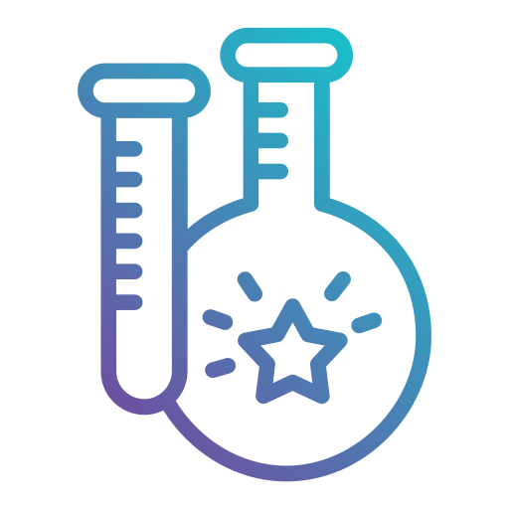



So far, building and scaling custom agents has been difficult
Fragmented frameworks | Creating a cohesive system through complex integration of various tools and APIs that have different interfaces, data formats, and requirements
Research vs production gap | New cutting-edge multi-agent patterns exist in research repos and they are hard to operationalize at scale
Slow iteration from local to prod | Local debugging, CI/CD integration, and reproducibility are clunky
Limited extensibility in closed systems | Managed services expose only pre-defined integrations and are hard to add custom plugins, domain logic, or enterprise integrations
Enterprise readiness gaps | Most OSS frameworks lack observability, security, compliance, and governance, and hard to monitor tool calls, enforce approvals, or guarantee safe behavior
Notes:
Building AI agents from scratch has traditionally been a complex and challenging task. There are several factors involved, such as integrating diverse tools and APIs that may have different interfaces and data formats. Interoperability is another hurdle, as agents need to work seamlessly across various platforms. Scalability is critical to ensure agents can handle growing data and workloads. Additionally, real-time processing, maintenance, and error handling add to the complexity. These challenges have made it difficult to rapidly deploy and scale AI agents that can be both effective and secure.

Slide 6
Organizations need frameworks that enable rapid development of performant, secure AI Agents
Current Frameworks
What’s Needed
Incompatible SDKs across frameworks, each having unique abstractions and little interoperability
Native support for standardized open protocols like MCP and A2A
Simple tool-calling but lack multi-agent communication patterns
Research-proven multi-agent patterns with threads, retries, and workflows
Prototype quickly in code on your laptop; deploy anywhere without rewrites
Hard to debug locally or integrate into CI/CD
Few guardrails for approvals, observability, or compliance
Built-in observability, security hooks, approvals, and long-running execution
Notes:
Organizations today are facing challenges in developing AI agents due to the limitations of current frameworks. These include a lack of integrated tools, security risks, and challenges in orchestrating complex workflows. What’s truly needed is a platform that connects complex workflow automation to enterprise data and seamlessly integrates with existing tools and applications. Flexible models must enable the processing of multiple types of data and modalities, and security must be built in to ensure compliance and data protection. The need is clear: organizations require platforms that make it easier to build and deploy scalable, secure AI agents rapidly.

Slide 7

Modern Agent Platform
Frictionless transition to production
Local-first prototyping
Open by design
Interop by design
One-stop integration fabric
Built-in guardrails
Notes:
Organizations today are facing challenges in developing AI agents due to the limitations of current frameworks. These include a lack of integrated tools, security risks, and challenges in orchestrating complex workflows. What’s truly needed is a platform that connects complex workflow automation to enterprise data and seamlessly integrates with existing tools and applications. Flexible models must enable the processing of multiple types of data and modalities, and security must be built in to ensure compliance and data protection. The need is clear: organizations require platforms that make it easier to build and deploy scalable, secure AI agents rapidly.

Slide 8

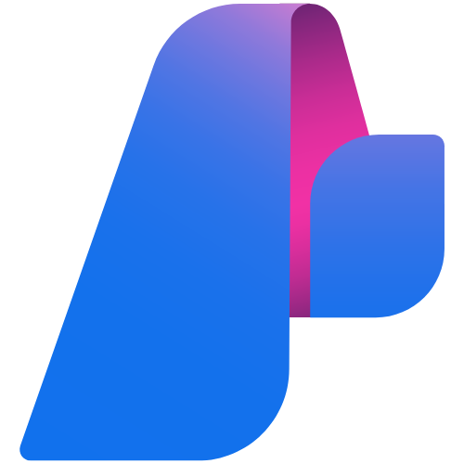
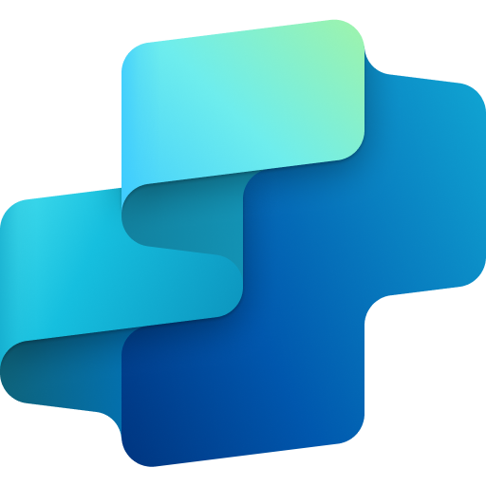
Microsoft has different ways of building agents
Platform Integrations, ease-of-use, and development speed
IaaS
PaaS
SaaS
Infrastructure-as-a-service
Platform-as-a-service
Software-as-a-service
Bring your own
Containers and frameworks
Azure AI Foundry
Copilot Studio
Agent Service
Agents
OSS LLMs and frameworks
Control, visibility, and customization

Slide 9
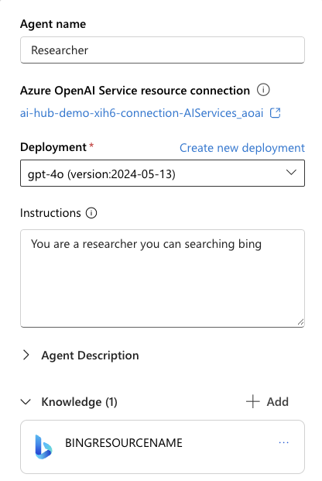
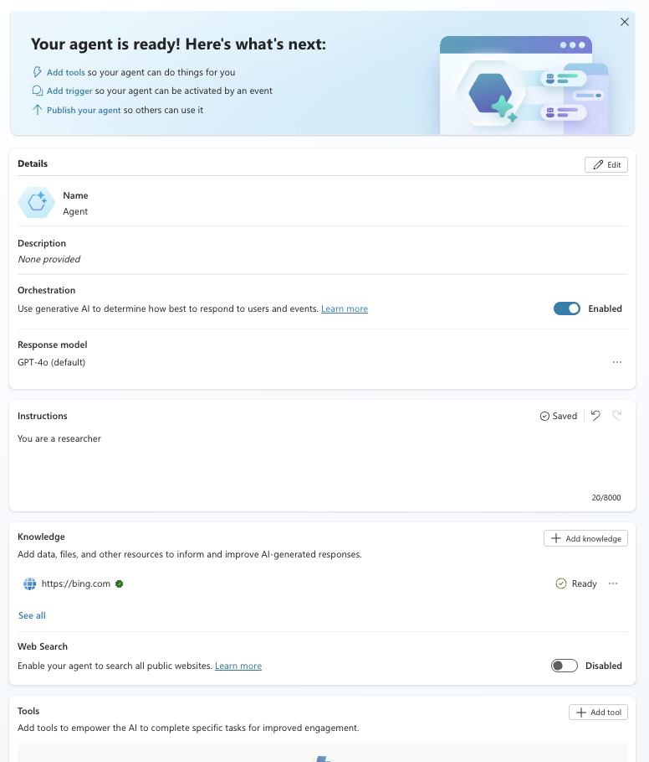
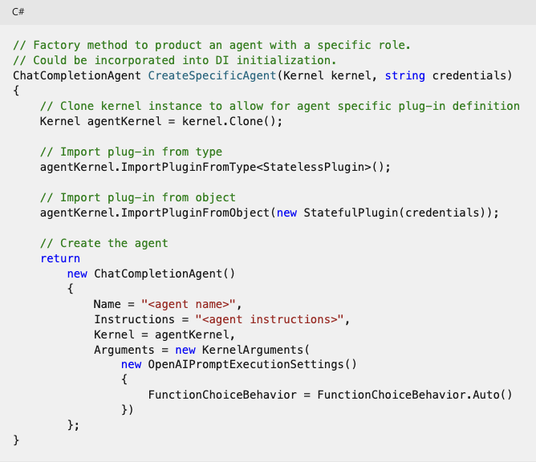
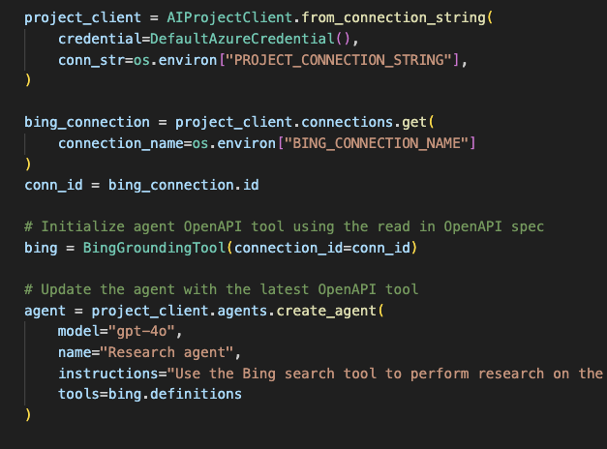
In each case, you provide a model, instructions, and tools
Containers and frameworks
Azure AI Foundry
Copilot Studio
OSS LLMs and frameworks
Agent Service
Agents
Copilot Studio manages the model for you

Slide 10



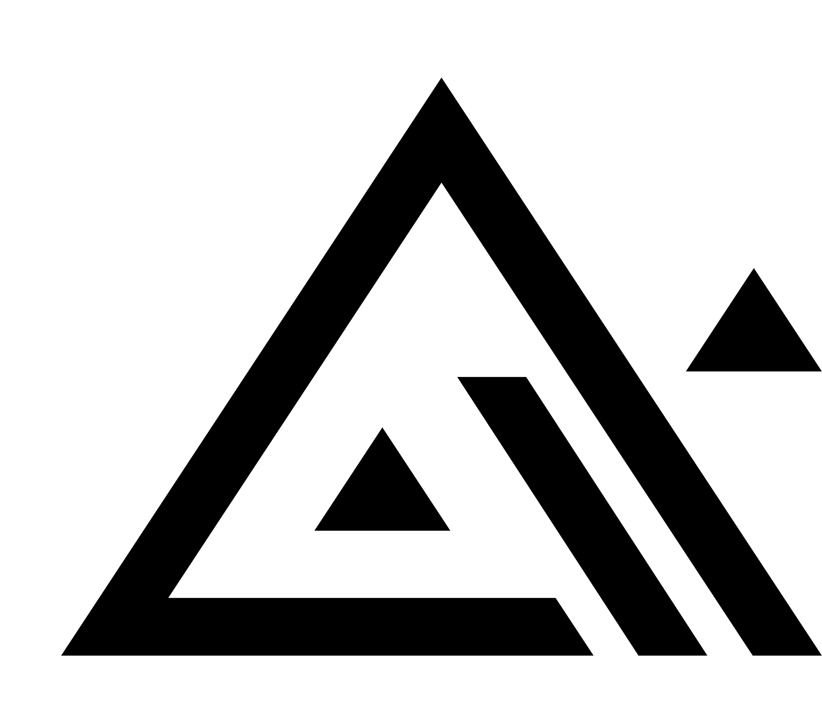





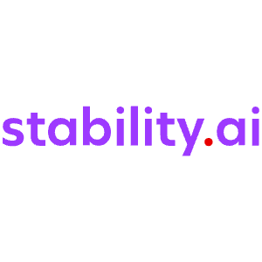


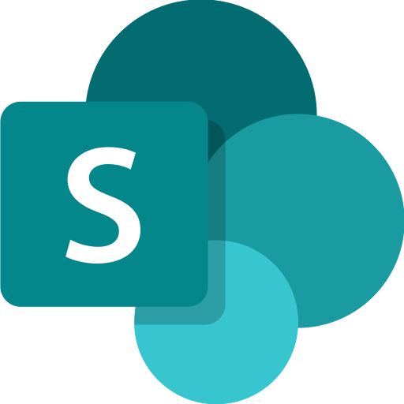






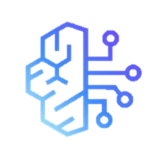

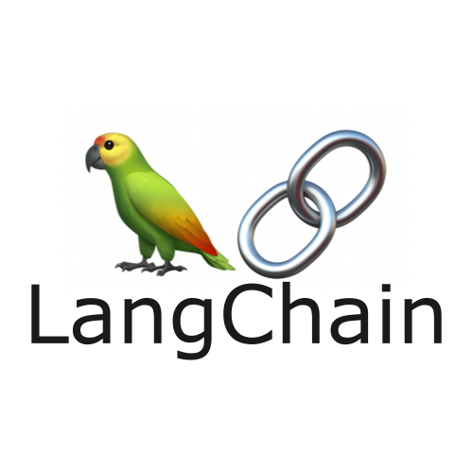
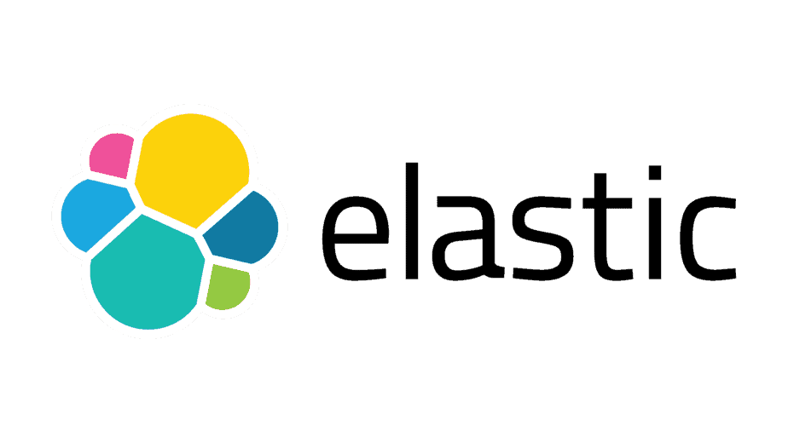

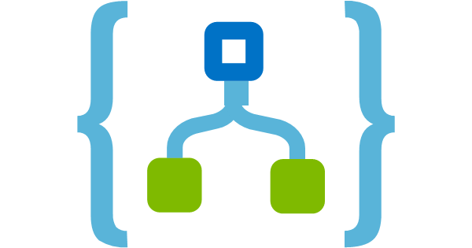

Authoring Tools
Foundry Models
Visual Studio
GitHub
Azure AI Foundry
AI Agent Ecosystem
OpenAI
Llama
Grok
Flux
Mistral
Knowledge
Agent catalog
Ready-made agents to kickstart your agent workforce
Phi
Cohere
Microsoft Fabric
Stability
Industry Models
Azure Cosmos DB
SharePoint
Foundry Labs
Microsoft Agent Framework
Client SDKs for enterprise and production agentic systems
Microsoft Graph
Muse
Magentic-One
Azure AI Search
Aurora
OmniParser
Agent tools
Orchestration
Channels
Microsoft Bing
Open Ecosystem
Enterprise Trust
Foundry Agent Service
Deploy and manage agents with fully-managed runtime
Protocols
A2A
MCP
OpenAPI
VNet deployments
Connectors
OBO Auth
Multi-agent workflows
Built-in threads
Long-term memory
Google VertexAI
Amazon Bedrock
CrewAI
LangChain
BYO-resources
ElasticSearh
Pinecone
Evaluation
Tracing & Monitoring
Governance + Safety
Managed Identities
Logic Apps
Azure Functions
Notes:
For use to show the agent factory ecosystem. NOT to be used in place of primary Foundry placemat/marketecture slide.

Slide 11
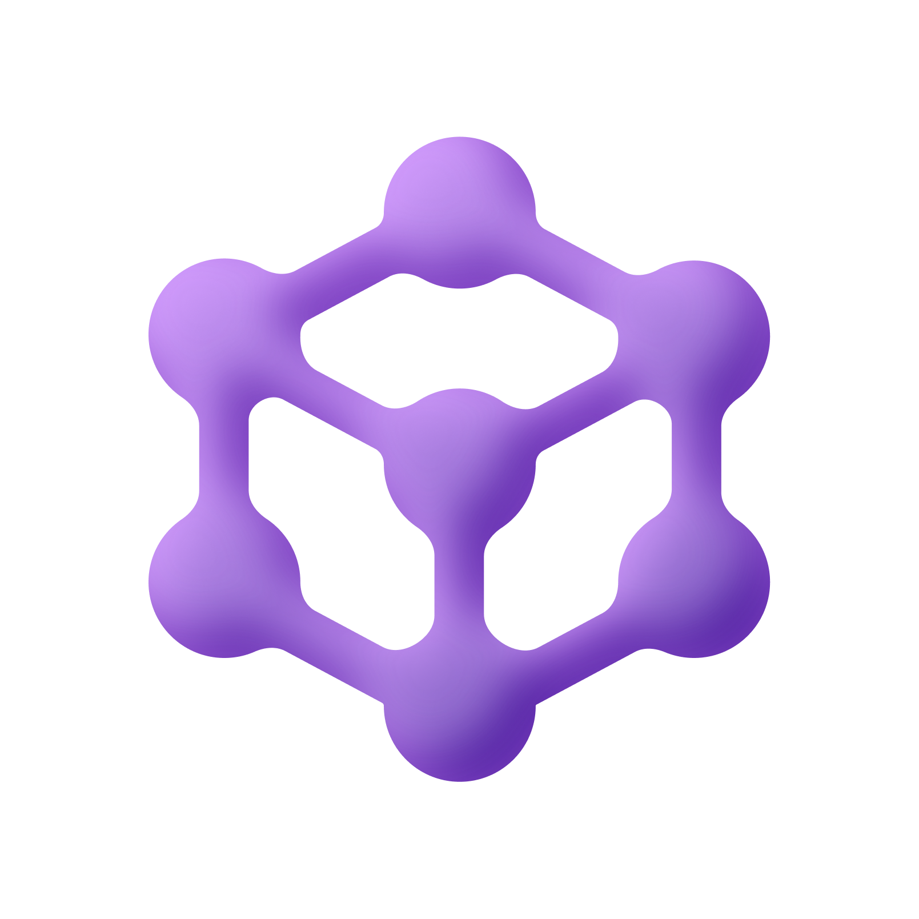
Microsoft Agent Framework
Open-source engine for building and orchestrating intelligent AI agents
Open Standards & Interoperability
Pipeline for Research
Community-Driven & Extensible by Design
Ready for
Production
aka.ms/AgentFramework
Notes:
Azure AI Agent Service is a flexible, use-case-agnostic platform for building, deploying, and managing AI agents. These agents can operate autonomously with human oversight, leveraging contextual data to perform tasks and achieve specified goals.
The service integrates cutting-edge models and tools from Microsoft, OpenAI, and partners like Meta, Mistral, and Cohere, providing an unparalleled platform for AI-driven automation. Through the Azure AI Foundry SDK and an intuitive Azure AI Foundry portal experience, developers can quickly create powerful agents while benefiting from Azure’s enterprise-grade security and performance guarantees.

Slide 12
Why Agents Need a New Foundation
Existing frameworks forced developers to choose between experimentation and production — Microsoft Agent Framework eliminates that tradeoff by unifying Semantic Kernel and AutoGen. [1]
Enterprise SDK
Research Project
Unified Platform
Semantic Kernel
AutoGen
Agent Framework
Stable SDK with enterprise connectors, workflows, and observability — but lacked multi-agent orchestration
Pioneered experimental multi-agent orchestration from Microsoft Research — but lacked enterprise readiness
Converges both into one open-source SDK and runtime: innovation plus enterprise-grade production support
Stable
Experimental
Open Source

Slide 13
Core Capabilities for Developers
The framework gives developers a unified programming model across .NET and Python to build, orchestrate, and deploy multi-agent systems.
Step 1
Step 3
Step 4
Step 5
Agents
Step 2
Workflows
Interop
Enterprise
Tools
Graph-based multi-agent orchestration with sequential, concurrent, handoff, and group chat patterns
Simple agent creation -- zero to a working agent in a few lines of code in .NET and Python
Type-safe function tools with OpenAPI, MCP, and A2A interoperability support
Multi-provider support: Azure OpenAI, Anthropic Claude, AWS Bedrock, Ollama, and more
Built-in observability via OpenTelemetry, compliance hooks, content moderation, and durable execution

Slide 14
Converging the two popular OSS frameworks
Microsoft Agent Framework
Semantic Kernel
AutoGen
Full SDK designed to build AI agents with ease, excellent for single agents and can be extended for multi-agents with integrations to AutoGen
Powerful multi-agent research framework with pre-built conversation orchestration patterns for handling complex agent systems
Notes:
Microsoft offers a variety of agentic frameworks for different levels of agent complexity. The Semantic Kernel is ideal for those seeking to build powerful, single-agent solutions with the flexibility to expand to multi-agent systems. AutoGen, a more robust multi-agent framework, provides pre-built orchestration patterns for managing complex systems and a low-code/no-code environment for building agents.

Slide 15
Unified SDK & Simple Agent Primitives
Run Agent
Create
Tools
Agent Framework introduces unified primitives (AIAgent, AgentThread, AgentTool) built on Microsoft.Extensions.AI.
Developers can create and run agents with minimal code and reuse the same abstractions across OpenAI, Foundry SDK, or any LLM backend.
Threads

Slide 16
Local-First,
Cloud-Agnostic
Client
Azure AI Foundry
Developers can run agents locally on their laptop, test against their preferred SDK (Azure OpenAI, OpenAI SDK, Foundry SDK), and then move the same code seamlessly to Foundry Agent Service (coming soon) or any cloud containers without rewrites.
Microsoft Agent Framework
Foundry Agent Service
Shared runtime
Unified SDK
Foundry SDK
Containers
Bedrock
AgentCore
Vertex AI
Agent Engine
AKS
ACA

Slide 17
Multi-Agent Orchestration
Sequential
Concurrent
Handoff
Inherit advanced orchestration patterns from Microsoft Research’s AutoGen combined with Semantic Kernel’s durable workflow orhcestration. Prototype experimental patterns locally, then scale them confidently in production.
Group Chat
Magentic
Workflow Process
worker
reviewer

Slide 18


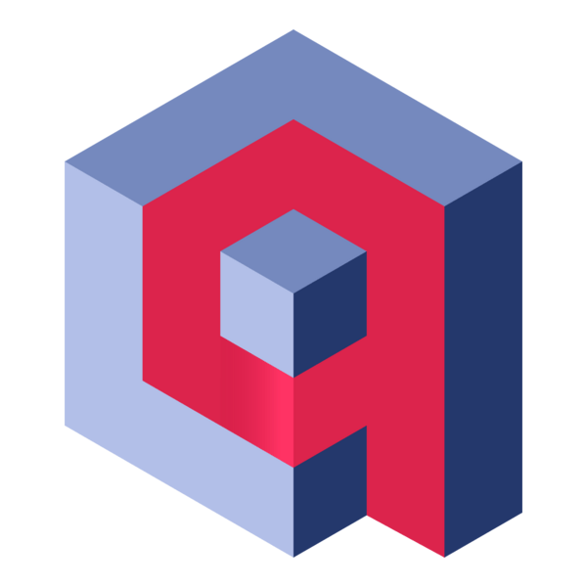

Tools and Extensibility
Open Ecosystem
Functions, APIs, and MCP servers can all be turned into tools.
Out-of-the-box integrations to common enterprise systems, databases, and SaaS APIs — so developers don’t start from scratch.
Developers can declaratively define agents in YAML and specify which tools require human approval.
A2A
MCP
OpenAPI
VertexAI
ElasticSearh
Pinecone
Amazon Bedrock
CrewAI
Logic Apps
Azure
Functions
LangChain
MongoDB
Cosmos DB
Chroma
Qdrant
Redis
SQL Server
Faiss
Weaviate

Slide 19
Single agent with tool
Agent architecture:
The agent can use a tool to help answer a user's question.
Request
"how's weather in SF?"
LLM
Tool
LLM
"San Francisco"
get_weather
{"temperature": 60,
"condition": "sunny"}
Response
"It's 60 degrees outside and the sun is shining! 🌞"

Slide 20
Single agent with tool
agent-framework
Define tools using Python functions, with typed args, return type, and docstring:
@tool
def get_weather(
city: Annotated[str, Field(description="City name, spelled out fully")],
) -> dict:
"""Returns weather data, a dict with temperature and description."""
return {"temperature": 72, "description": "Sunny"}
agent = Agent(client=client,
instructions="You're an info agent. Answer questions cheerfully.",
tools=[get_weather])
response = await agent.run("Whats weather today in San Francisco?")
print(response.text)
Full example: agent_tool.py

Slide 21
Single agent with multiple tools
Agent architecture:
The agent must decide which tool to use and what order to call tools in.
Weekend planner agent
LLM
LLM
Tool A
Tool B
Tool C
get_weather
get_activities
get_current_date

Slide 22
Single agent with tools
agent-framework
@tool
def get_current_date() -> str:
return datetime.now().strftime("%Y-%m-%d")
@tool
def get_weather(
city: Annotated[str, Field(description="The city to get weather for")]) -> dict:
...
@tool
def get_activities(
city: Annotated[str, Field(description="The city to get activities for")],
date: Annotated[str, Field(description="Date, in format YYYY-MM-DD.")]) -> list:
...
agent = Agent(client=client, instructions="You help users plan their weekends.",
tools=[get_weather, get_activities, get_current_date])
Full example: agent_tools.py

Slide 23
Local experimentation with DevUI
agent-framework
DevUI makes it easy to chat with your agents and trace tool calls:
from agent_framework.devui import serve
serve(entities=[agent], auto_open=True)

Slide 24
Integrating agents with MCP server tools

Slide 25
Agent with local MCP server
agent-framework
First run the server:
uv run examples/mcp_server.py
Then run the agent:
async with (
MCPStreamableHTTPTool(name="Local MCP Server",
url="http://localhost:8000/mcp") as mcp_server,
Agent(client=client,
instructions=f"You help users with tasks using the available tools.
Today's date is {datetime.now().strftime('%Y-%m-%d')}.",
tools=[mcp_server]) as agent,
):
response = await agent.run("I bought laptop today for $1200 on my visa.")
Full example: agent_mcp_local.py

Slide 26
Agent with remote MCP server
agent-framework
async with (
MCPStreamableHTTPTool(
name="Microsoft Learn MCP",
url="https://learn.microsoft.com/api/mcp") as mcp_server,
Agent(
client=client,
instructions="You help with Microsoft documentation questions. Use the available tools to search for relevant docs.",
tools=[mcp_server]) as agent,
):
response = await agent.run(
"How do I create an Azure Blob storage account using the az cli?")
Full example: agent_mcp_remote.py

Slide 27
Agent middleware

Slide 28
Agent Middleware example
agent-framework
A middleware should process, call_next(), then optionally post-process:
async def timing_agent_middleware(
context: AgentContext,
call_next: Callable[[], Awaitable[None]],
) -> None:
start = time.perf_counter()
logger.info("[⏲️ Timing Agent Middleware] Starting agent execution")
await call_next()
elapsed = time.perf_counter() - start
logger.info(f"[⏲️ Timing Agent Middleware] Execution took {elapsed:.2f}s")
Full example: agent_middleware.py

Slide 29
Middleware scenarios
Agent Middleware:
Logging & timing
Content filtering / blocking
Authorization checks
Result caching
Result override
Thread summarization
Dynamic system prompts
Chat Middleware:
Token tracking
Latency tracking
Budget enforcement
PII redaction
Response moderation
Model fallback
Model call limits
Function Middleware:
Audit logging
Permission checks
Input validation
Caching results
HITL approval
Tool call limits
Tool retry with backoff
Once you build a middleware for one agent, you can reuse across other agents.
You might create a central package of middleware for many agents to use.

Slide 30
Multi-agent architectures

Slide 31
Supervisor agent with sub-agents
Agent architecture:
The supervisor agent decides which specialist agents should handle a task.
Each agent may still have associated tools to call.
General architecture
Parenting helper agent
Supervisor Agent
Supervisor Agent
Agent A
Agent B
Weekend Planning Agent
Meal
Planning Agent
Search Activities
Check Weather
Search Recipes
Check Fridge

Slide 32
Supervisor agent with sub-agents
agent-framework
weekend_agent = Agent(client=client,
instructions="You help users plan weekend activities based on weather",
tools=[get_weather, get_activities, get_current_date])
meal_agent = Agent(client=client,
instructions="You help users plan meals + choose the best recipes",
tools=[find_recipes, check_fridge])
@tool
async def plan_weekend(query: str) -> str:
response = await weekend_agent.run(query)
return response.text
@tool
async def plan_meal(query: str) -> str:
response = await meal_agent.run(query)
return response.text
supervisor_agent = Agent(client=client,
instructions="You're a supervisor managing a weekend planner & meal planner",
tools=[plan_meal, plan_weekend])
Full example: agent_supervisor.py

Slide 33
Python + Agents
🛠️ Building your first agent in Python
aka.ms/pythonagents/slides/building – Find more info here

Slide 34
Memory & Conversation State
Thread
Travel Planning
Memory
Run 1
User’s message
I need to book a hotel in New York for 2 stays.
Trip to New York
1
Use Tripadvisor API to search the nearest hotel
The AgentThread abstraction retains conversation history across turns and sessions, ensuring agents have relevant context for long-running dialogues.
Agent Framework provides short-term memory (session-scoped, immediate context) and long-term memory (persistent data for user preferences, facts, etc.) through integrations with vector DBs.
Agent’s message
Here are some suggestions:
2
Create message
User’s message
What’s the daily meal allowance for the business trip?
Run 2
Daily meal allowance
1
Agent’s message
The daily allowance for your business trip is $75, as per company policy.
Use Microsoft SharePoint to query the company travel policy
2
Create message

Slide 35
Context is everything
The context to an agent is all the inputs that help the agent decide what action it will take next and how it will respond.
📋 Overall instructions
💻 Environment information
📚 Domain-specific knowledge
🧠 Memories from previous conversations
💬 Past messages in the session
🛠️ Tool descriptions, calls, results
You're a friendly weather assistant.
Today's date is Feb 25, 2026.
There is an emergency alert today for CA citizens due to wildfire risk.
The current user lives in California.
⚙️
Weather in Tokyo?
👤
get_weather("Tokyo")
LLM
Sunny, 25°C
🔧
It's sunny in Tokyo at 25°C
LLM

Slide 36
Memory
Can LLM remember past messages?
Can app remember past conversations?
Can LLM remember facts from past conversations?
Session
Within conversation, just messages and tool calls
Can be stored in-memory OR persisted to a database to restore conversation later
May require truncation or summarization
Chat history
Must be stored in a persistent database
Across conversations, typically tied to user ID
Dynamic memory
Must be stored in a persistent database
Retrieve memories, optionally using search to find most relevant
https://learn.microsoft.com/agent-framework/user-guide/agents/agent-memory

Slide 37
Python + Agents
🧠 Adding context and memory to agents
aka.ms/pythonagents/slides/contextmemory – Find more info here
Notes:
Use the following slide deck to go thru the concepts: aka.ms/pythonagents/slides/contextmemory

Slide 38
Observability with OpenTelemetry (OTel)
OTel standardizes how applications emit traces, metrics, and logs — making debugging and performance analysis consistent across languages and vendors.
Traces
Metrics
Logs
0ms
30ms
__/‾‾‾ cpu_usage: 30%
‾‾\__ latency_p95: 43ms
_/‾\__ errors: 0.2%
INFO: 2025-12-05: Server running
{"region": "westus"}
ERROR: 2025-12-05: User not found
{"user_id": 123}
parent-span
child-span
Operations composed of spans that show how a request moves through services, including timing, dependencies, and context propagation.”
Numeric measurements such as CPU usage, request counts, latency, error rates, or any custom app metric.
Structured log records with message, severity, time stamp,
and contextual attributes.

Slide 39
Using OpenTelemetry with Agent Framework
Agent framework has built-in support for generating OpenTelemetry traces.
Set ENABLE_CONSOLE_EXPORTERS=true in environment for console traces.
from agent_framework.observability import configure_otel_providers
configure_otel_providers(enable_sensitive_data=True)
agent = Agent(
name="weather-time-agent",
client=client,
instructions="You're an assistant that can look up weather and time.",
tools=[get_weather, get_current_time])
response = await agent.run(
"What's the weather in Seattle and what time is it in Tokyo?")
Full example: agent_otel_aspire.py

Slide 40
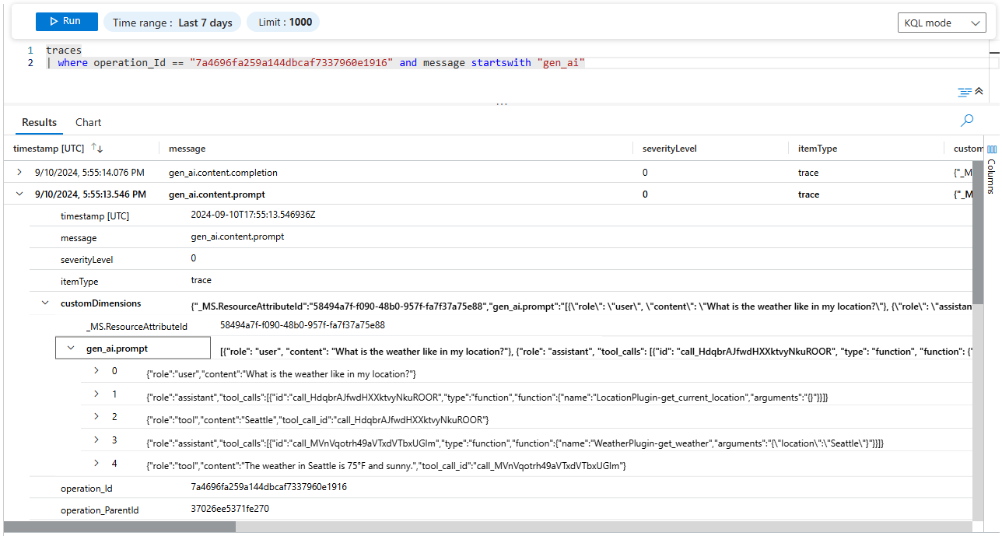
Enterprise-ready Foundations
Logging
Built-in guardrails for enterprise scenarios: user approval flows, hooks for content policy, observability via OpenTelemetry, and support for long-running agent execution.
Integrated directly with Azure identity (Microsoft Entra ID), policy enforcement, and content filters, making it safe to embed in enterprise workflows
Tracing

Slide 41
OTel-compliant observability platforms
 | Open source? | Managed version?
Aspire | ✅ | ❌
Azure Application Insights | ❌ | ✅
Datadog | ❌ | ✅
Grafana | ✅ | ✅
Prometheus | ✅ | (via Grafana)
Jaeger | ✅ | ❌
Logfire | ✅ | ✅
...and many more!
Notes:
https://newsletter.pragmaticengineer.com/p/the-pragmatic-engineer-2025-survey-part-3

Slide 42
Exporting OTel to Azure App Insights
Install in pyproject.toml:
azure-monitor-opentelemetry
Use wrapper function configure_azure_monitor to configure global exporters based off the App Insights connection string:
from azure.monitor.opentelemetry import configure_azure_monitor
from agent_framework.observability import create_resource, enable_instrumentation
configure_azure_monitor(
connection_string=os.environ["APPLICATIONINSIGHTS_CONNECTION_STRING"],
resource=create_resource(),
enable_live_metrics=True,
)
enable_instrumentation(enable_sensitive_data=True)
Full example: agent_otel_appinsights.py

Slide 43
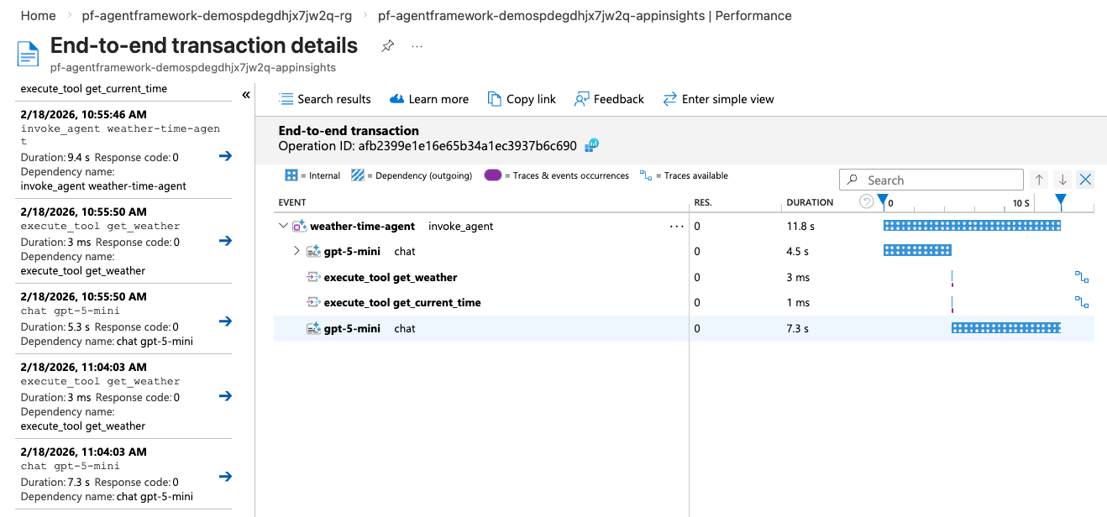
Viewing traces in Azure App Insights
1. Navigate to App Insights in Portal
2. Find traces in Performances, Failures, or Logs tabs
3. Create dashboards of what matters to you

Slide 44
Python + Agents
📊 Monitoring and evaluating agents
aka.ms/pythonagents/slides/monitoreval – Find more info here

Slide 45
What's a workflow?
An agentic workflow is any flow that involves an agent at some point,
typically to handle decision making or answer synthesis.
Processing
or
Data Lookup
🤖
Processing
or
Data Lookup
Input
Agent
Output
Tool
Tool
Not all calls in our systems should be agentic!
Every call to an LLM increases the non-determinism of a system and possibility of failure or safety risk. 😬

Slide 46
Anatomy of a workflow
agent-framework
A workflow is a graph with Executor nodes and edges between them:
Input
Executor
edge
Executor
edge
Executor
Output
Each executor subclass defines handler methods that receive messages and may send messages to next executor and/or yield outputs:
class SampleExecutor(Executor):
@handler
async def sample_handler(self, text: str, ctx: WorkflowContext[str]):
await ctx.send_message(text.upper())
class OutputExecutor(Executor):
@handler
async def sample_handler(self, text: str, ctx: WorkflowContext[Never, str]):
await ctx.yield_output(text)

Slide 47
Building a workflow
agent-framework
Use WorkflowBuilder() to connect instances of Executor() subclasses:
from agent_framework import WorkflowBuilder
extract = ExtractExecutor(id="extract")
chunk = ChunkExecutor(id="chunk")
embed = EmbedExecutor(id="embed")
workflow = WorkflowBuilder(start_executor=extract)
.add_edge(extract, chunk)
.add_edge(chunk, embed).build()
events = await workflow.run(pdf_path)
outputs = events.get_outputs()
Input
ExtractExecutor
ChunkExecutor
EmbedExecutor
Full example: workflow_rag_ingest.py
Output

Slide 48
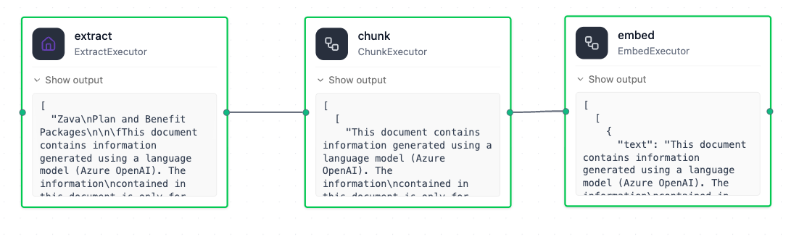
Visualize workflows with DevUI
agent-framework
Install the devui package:
agent-framework-devui
Point devui to the workflow:
from agent_framework.devui import serve
serve(entities=[workflow], auto_open=True)
Run the workflow and see the progress through each node:

Slide 49
Workflows with Agent executors
agent-framework
Every Agent instance can also be used as an Executor in a workflow:
writer = Agent(client=client,
name="Writer",
instructions="You are a concise content writer.")
reviewer = Agent(client=client,
name="Reviewer",
instructions="Review content based on clarity, accuracy, and structure.")
workflow = WorkflowBuilder(start_executor=writer)
.add_edge(writer, reviewer)
.build()
Full example: workflow_agents.py
Notes:
Handoffs?

Slide 50
Streaming events from workflows
agent-framework
Emit events from workflows by specifying stream=True:
async for event in workflow.run(prompt, stream=True):
if event.type == "started":
print(f"[started] for workflow {workflow.name}")
elif event.type == "executor_invoked":
print(f"[executor_invoked] from executor {event.executor_id}")
elif event.type == "output" and isinstance(event.data, AgentResponseUpdate):
print(event.data.text, end="", flush=True)
elif event.type == "executor_completed":
print(f"[executor_completed] from executor {event.executor_id}")
elif event.type == "executor_failed":
print(f"[executor_failed] from executor {event.executor_id}: {event.data}")
elif event.type == "error":
print(f"[error] {event.data}")
Full example: workflow_agents_streaming.py
Notes:
https://learn.microsoft.com/agent-framework/workflows/events

Slide 51
Built-in workflow builder: SequentialBuilder
agent-framework
If you're building a linear conversation pipeline, you can use SequentialBuilder:
from agent_framework.orchestrations import SequentialBuilder
workflow = SequentialBuilder(participants=[writer, reviewer])
.build()
The workflow assumes that participants accept and emit conversation-shaped data, so executors must be Agents or custom Executors that process conversations.
The extra start/end nodes normalize input and output to list[Message].
Full example: workflow_agents_sequential.py
Notes:
https://learn.microsoft.com/agent-framework/workflows/events

Slide 52
Branching workflows

Slide 53
Workflow with conditional branching
agent-framework
Each edge in a graph can have a condition (function that returns True/False).
def needs_revision(message) -> bool:
return message.agent_response.text.upper().startswith("REVISION NEEDED")
def is_approved(message) -> bool:
return message.agent_response.text.upper().startswith("APPROVED")
workflow = (WorkflowBuilder(start_executor=writer)
.add_edge(writer, reviewer)
.add_edge(reviewer, publisher, condition=is_approved)
.add_edge(reviewer, editor, condition=needs_revision)
.build())
Full example: workflow_conditional.py
Notes:
Handoffs?

Slide 54
State management

Slide 55
When do we need workflow state?
Without state:
With state:
stores
"These are 5 reasons why..."
state:
key | value
post_text | "These are 5 reasons why..."
{
"decision": "APPROVED",
"post_text": "These are 5.."
}
{
"decision": "APPROVED"
}
reads
Reviewer must carry content that it didn't produce, just to pass it downstream.
Reviewer only decides. Draft is stored once and read by any step that needs it.
Notes:
Handoffs?

Slide 56
Storing and accessing state in workflows
agent-framework
@executor(id="store_post_text")
async def store_post_text(response, ctx):
ctx.set_state("post_text", response.agent_response.text.strip())
await ctx.send_message(response)
@executor(id="publisher")
async def publisher(response, ctx):
content = str(ctx.get_state("post_text", "")).strip()
await ctx.yield_output(f"✅ Published:\n\n{content}")
workflow = (WorkflowBuilder(start_executor=writer, max_iterations=8)
  .add_edge(writer, store_post_text)
  .add_edge(store_post_text, reviewer)
  .add_edge(reviewer, publisher, condition=is_approved)
  .add_edge(reviewer, editor, condition=needs_revision)
  .add_edge(editor, store_post_text)
  .build())
store state
access state
Full example: workflow_conditional_state.py
Notes:
Handoffs?

Slide 57
Python + Agents
🔀 Building your first AI-driven workflows
aka.ms/pythonagents/slides/workflows – Find more info here

Slide 58
Built-in workflow orchestrations
https://learn.microsoft.com/agent-framework/workflows/orchestrations/
Notes:
"Everything we've built so far — sequential, conditional, fan-out — the developer decides the topology. Now we let the agents decide."

Slide 59
Demos and Videos
Showcasing

Slide 60
Demos and Videos
Showcasing

Slide 61
End-to-end application

Slide 62
Agentic AI investment analysis
Agent Framework*
FastAPI
Azure OpenAI
Azure Cosmos DB
Azure Blob Storage
*Uses an older MAF version,
upgrades are pending.
https://github.com/Azure-Samples/Agentic-AI-Investment-Analysis-Sample
Notes:
https://aiinvest-web-dev.blueground-1750adc3.westus2.azurecontainerapps.io/

Slide 63
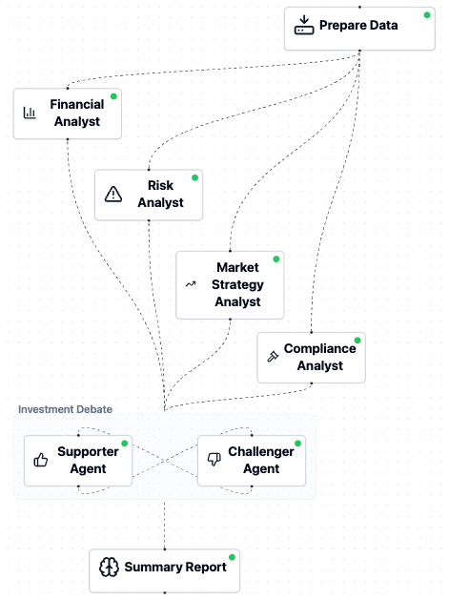
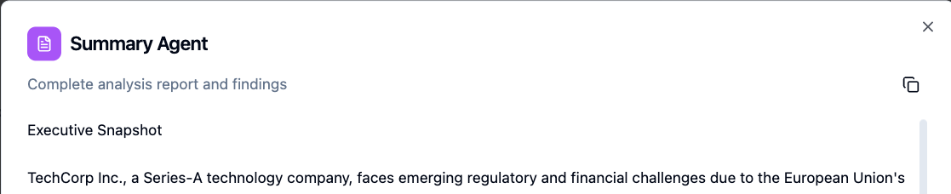
Investment workflow with fan-out/fan-in
workflow = WorkflowBuilder()
.set_start_executor(data_prep_executor)
.add_fan_out_edges(data_prep_executor,
[financial_analyst, risk_analyst,
market_analyst, compliance_analyst])
.add_fan_in_edges(
[financial_analyst, risk_analyst,
market_analyst, compliance_analyst],
analysis_aggregator)
.add_edge(analysis_aggregator, debate_executor)
.add_edge(debate_executor, summary_report_generator)
.build()
Full file: investment_workflow.py
Notes:
Each sub-agent is a tool called by the supervisor.

Slide 64
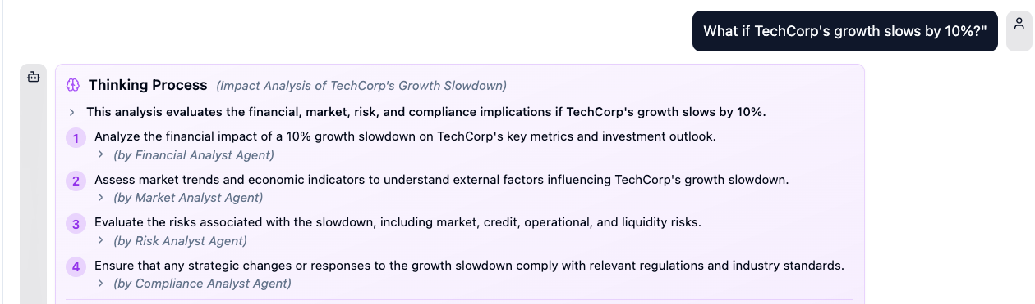
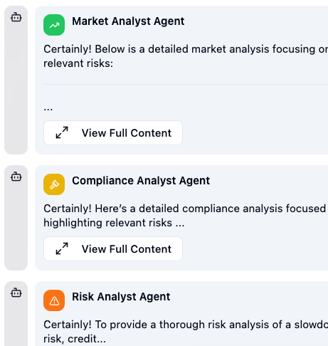
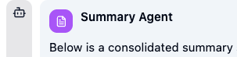

What-if workflow with fan-in/fan-out
workflow = WorkflowBuilder()
.set_start_executor(planner_agent)
.add_fan_out_edges(planner_agent,
[financial_analyst_agent, risk_analyst_agent,
market_analyst_agent, compliance_analyst_agent])
.add_fan_in_edges(
[financial_analyst_agent, risk_analyst_agent,
market_analyst_agent, compliance_analyst_agent],
summarizer_agent)
.build()
Full file: what_if_workflow.py
Notes:
Each sub-agent is a tool called by the supervisor.

Slide 65
Python + Agents
🕸️ Orchestrating advanced multi-agent workflows
aka.ms/pythonagents/slides/advancedworkflows – Find more info here

Slide 66
Why add a human in the loop?

Slide 67
Why add a human in the loop?
LLMs can produce uncertain, inconsistent, or incorrect outputs.
Human checkpoints provide:
🎯 Accuracy | Verify factual correctness before acting
🛡️ Safety | Gate sensitive operations (refunds, emails, deployments)
🤝 Trust | Users see what the system will do before it acts
📋 Compliance | Audit trail of human approvals for regulated workflows
🚦Control | Humans can redirect, refine, or halt a workflow at any point

Slide 68
HITL patterns in agent-framework
Tool approval | Sensitive tool calls must be approved before execution
Requests and responses | Workflow needs human input to continue (answers, choices, feedback)
Checkpoints & resuming | Long-running tasks where human may not be immediately available
Handoff with HITL | Dynamic multi-agent routing with interactive user input between handoffs
Notes:
Which are agents vs workflows?

Slide 69
Tool approval
https://learn.microsoft.com/agent-framework/agents/tools/tool-approval

Slide 70
Requests and responses
https://learn.microsoft.com/agent-framework/workflows/requests-and-responses

Slide 71
Checkpoints and resuming
https://learn.microsoft.com/agent-framework/workflows/checkpoints

Slide 72
Handoff orchestration with HITL
https://learn.microsoft.com/agent-framework/workflows/orchestrations/handoff

Slide 73
End-to-end application

Slide 74
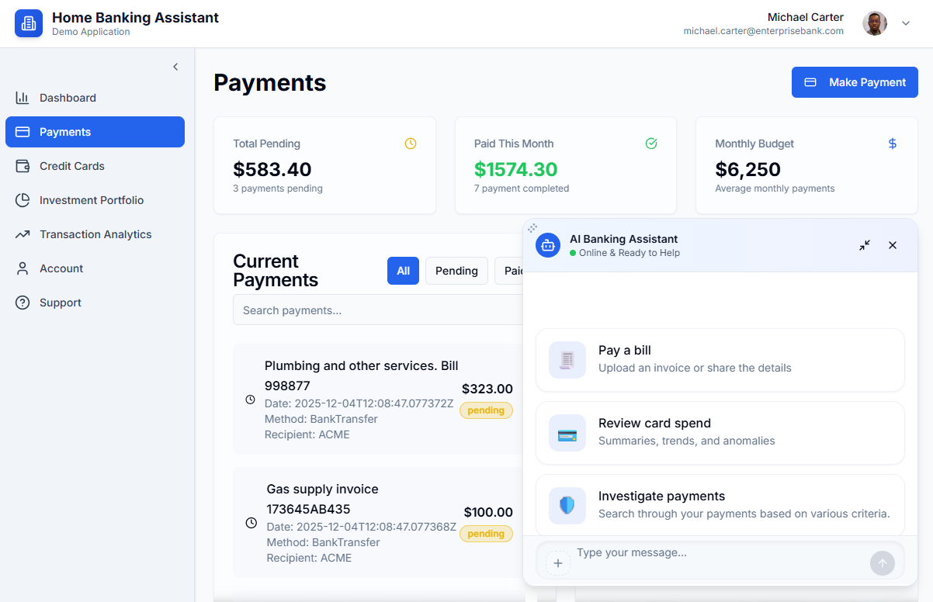
Agentic banking assistant
Python frameworks:
Agent Framework
FastMCP
Azure services:
OpenAI
Document Intelligence
Container Apps
https://github.com/Azure-Samples/agent-openai-python-banking-assistant
Notes:
https://aiinvest-web-dev.blueground-1750adc3.westus2.azurecontainerapps.io/

Slide 75
Agents and MCP servers architecture
Multi-Agent App
FastMCP
Users
Agent Framework
MCP tools:
getAccountByUsername
getAccountDetails
getPaymentMethods
getCreditCards
1
Account Agent
1
Account
Service
Question or task about personal banking account,
transactions, invoice payment
Responsible for all tasks related to banking account info, credit balance, registered payment methods.
MCP tools:
Tools
HTTP
Streaming
submitPayment
MCP1
1
2
Payments
Service
Hand-off to Account
Supervisor Agent
Transaction Agent
MCP tools:
Act as triage agent understanding the user intent based on chat and route the request to the specific domain agent
Responsible for all tasks related to querying user bank movements like income and outcome payments.
1
notifyTransaction
searchTransactions
getTransactionByRecipient
Hand-off to Transaction
3
Reporting
Service
Tools
MCP1, MCP3
Microsoft Foundry
Hand-off to Payment
Payment Agent
Responsible for all tasks related to submit a payment.
Azure Open AI
Azure Document
Intelligence
GPT models
Tools
MCP1, MCP2,
MCP3, ScanInvoice
GPT and embeddings models
Extract entities from Invoices
Notes:
Each sub-agent is a tool called by the supervisor.

Slide 76
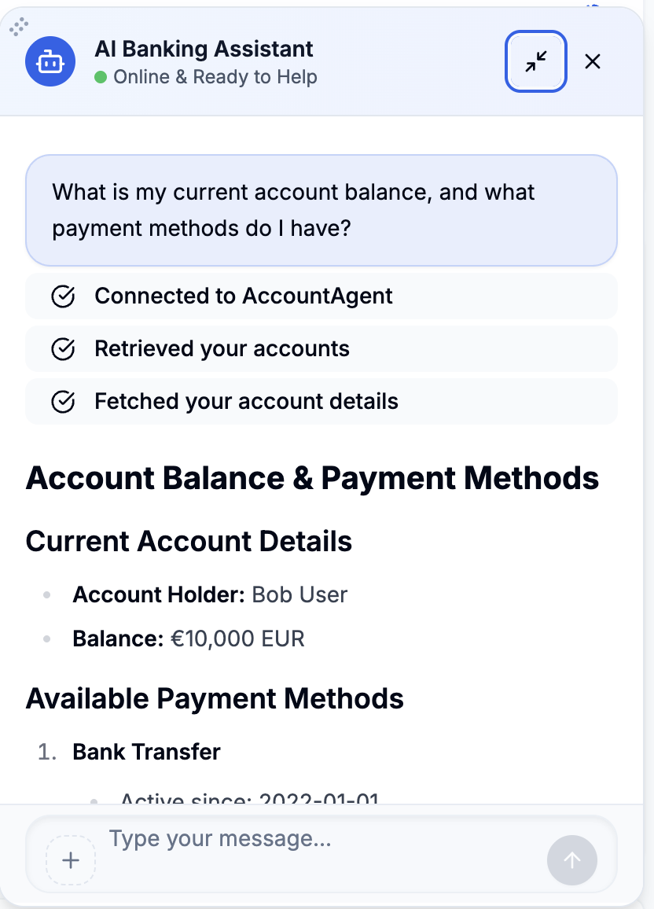
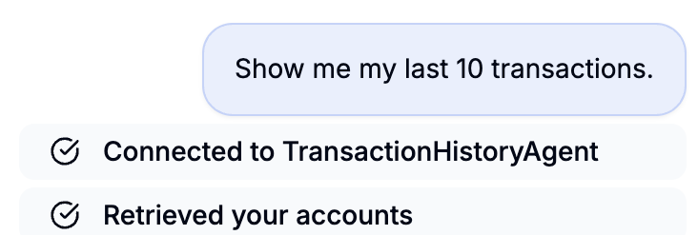
Handoff workflow with checkpointing
workflow = (HandoffBuilder(
participants=[triage_agent,
await self.account_agent.build_af_agent(),
await self.transaction_agent.build_af_agent(),
await self.payment_agent.build_af_agent()])
.with_start_agent(triage_agent)
.with_checkpointing(checkpoint_storage)
.build())
Full file: handoff_orchestrator.py
Notes:
Each sub-agent is a tool called by the supervisor.

Slide 77
Python + Agents
🙋🏽 Adding a human-in-the loop to workflows
aka.ms/pythonagents/slides/hitl – Find more info here

Slide 78


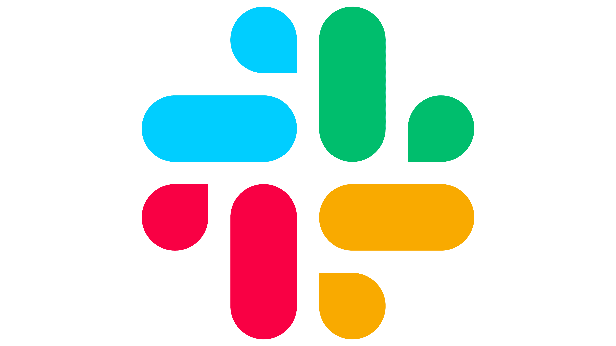

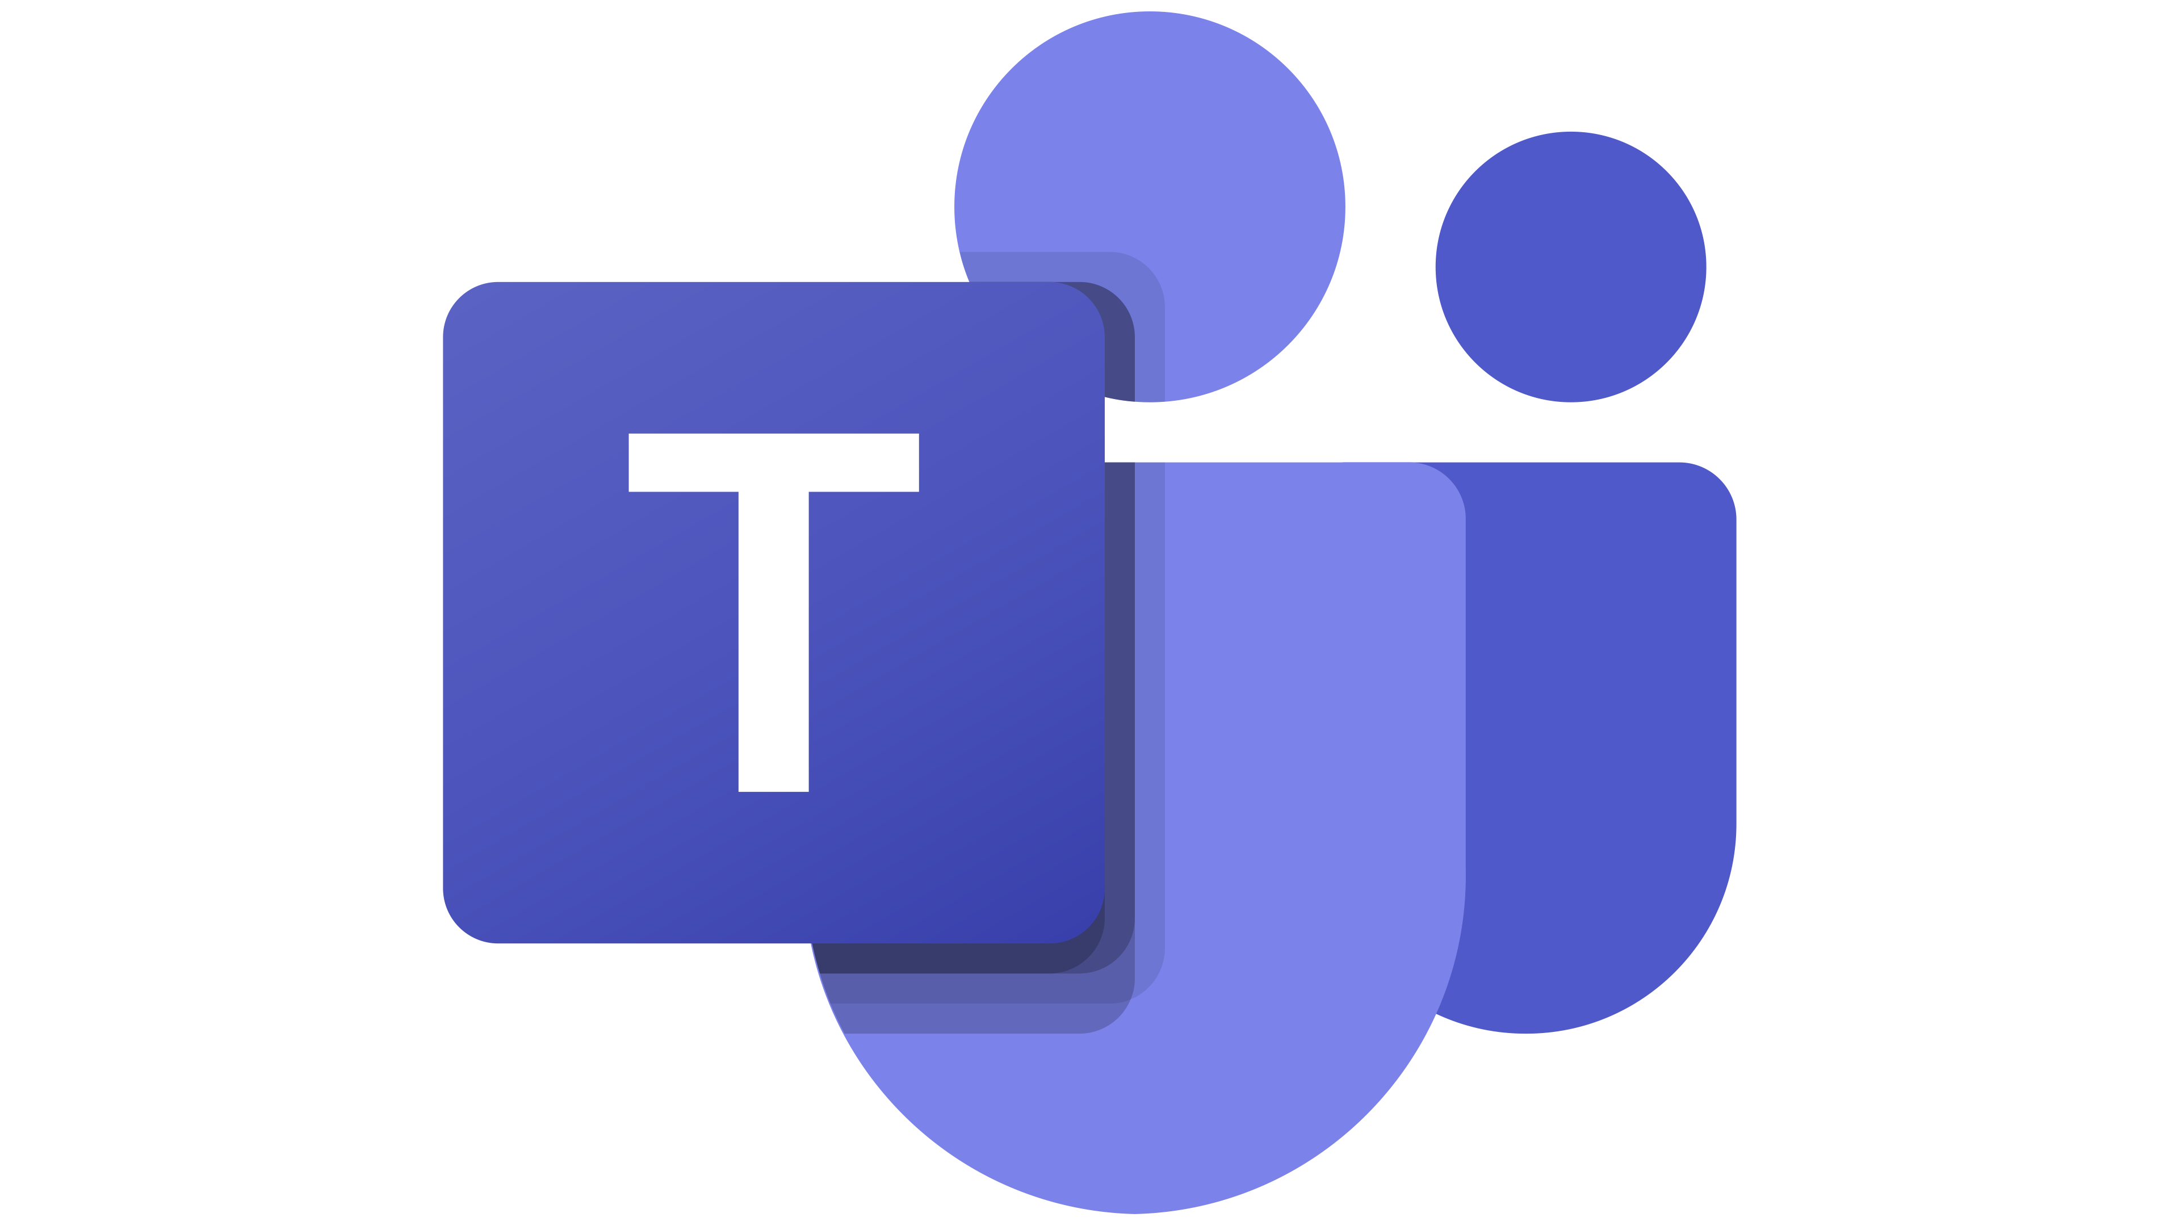
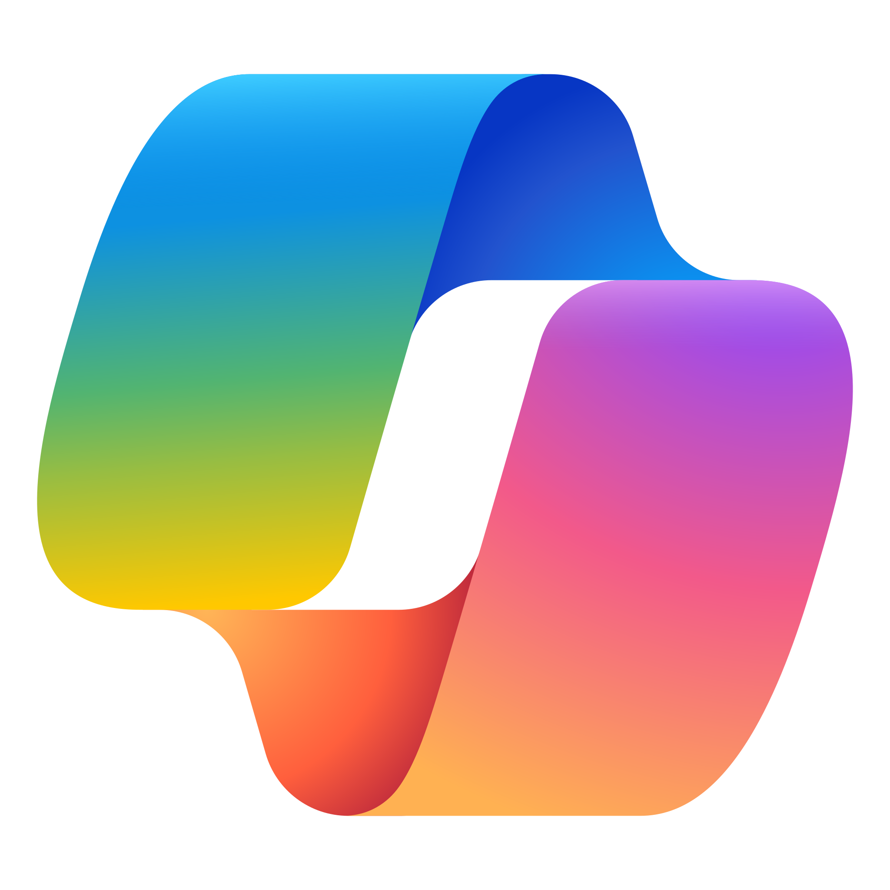

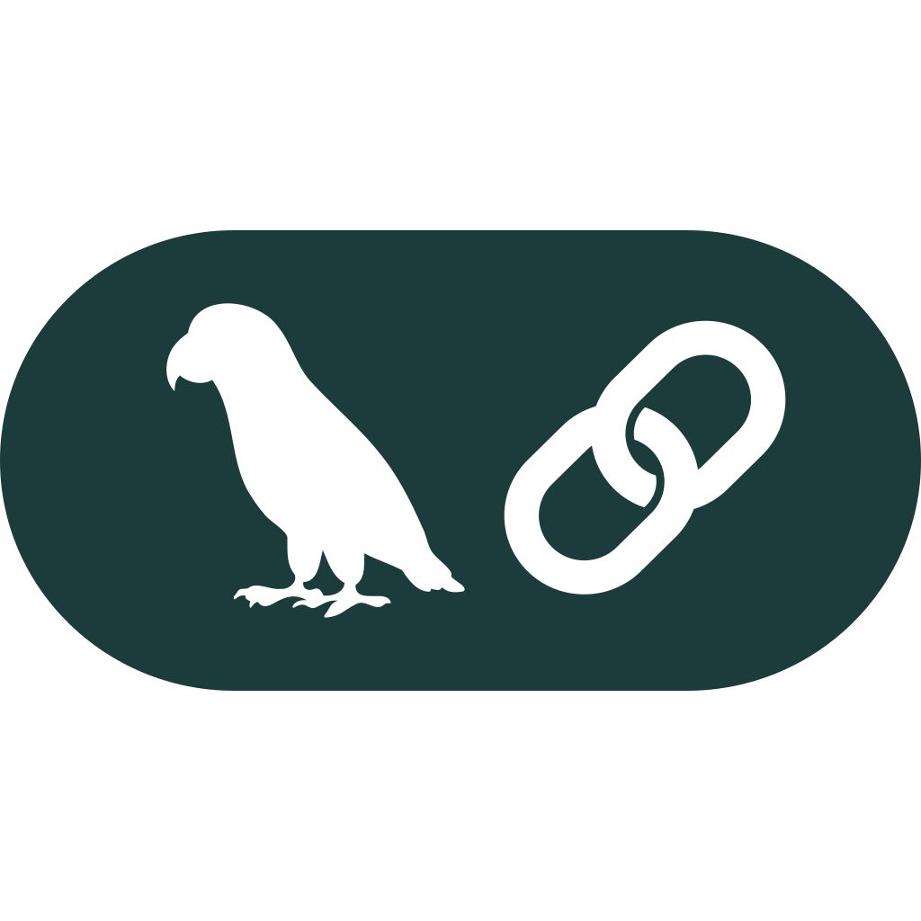
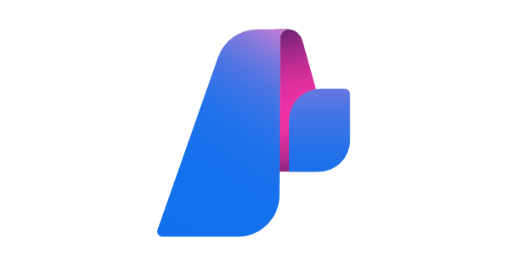



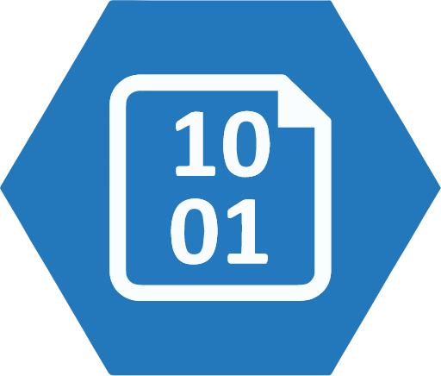


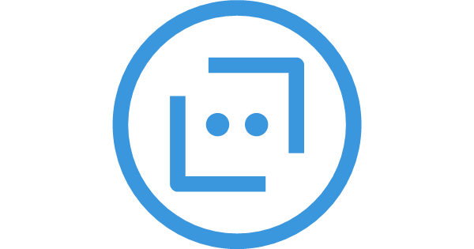

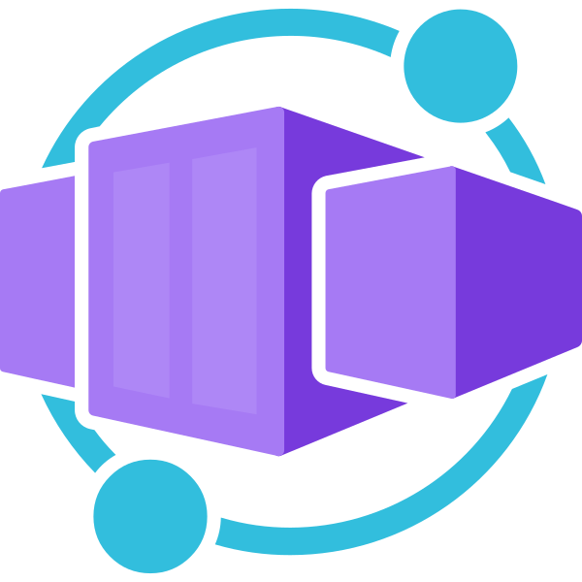

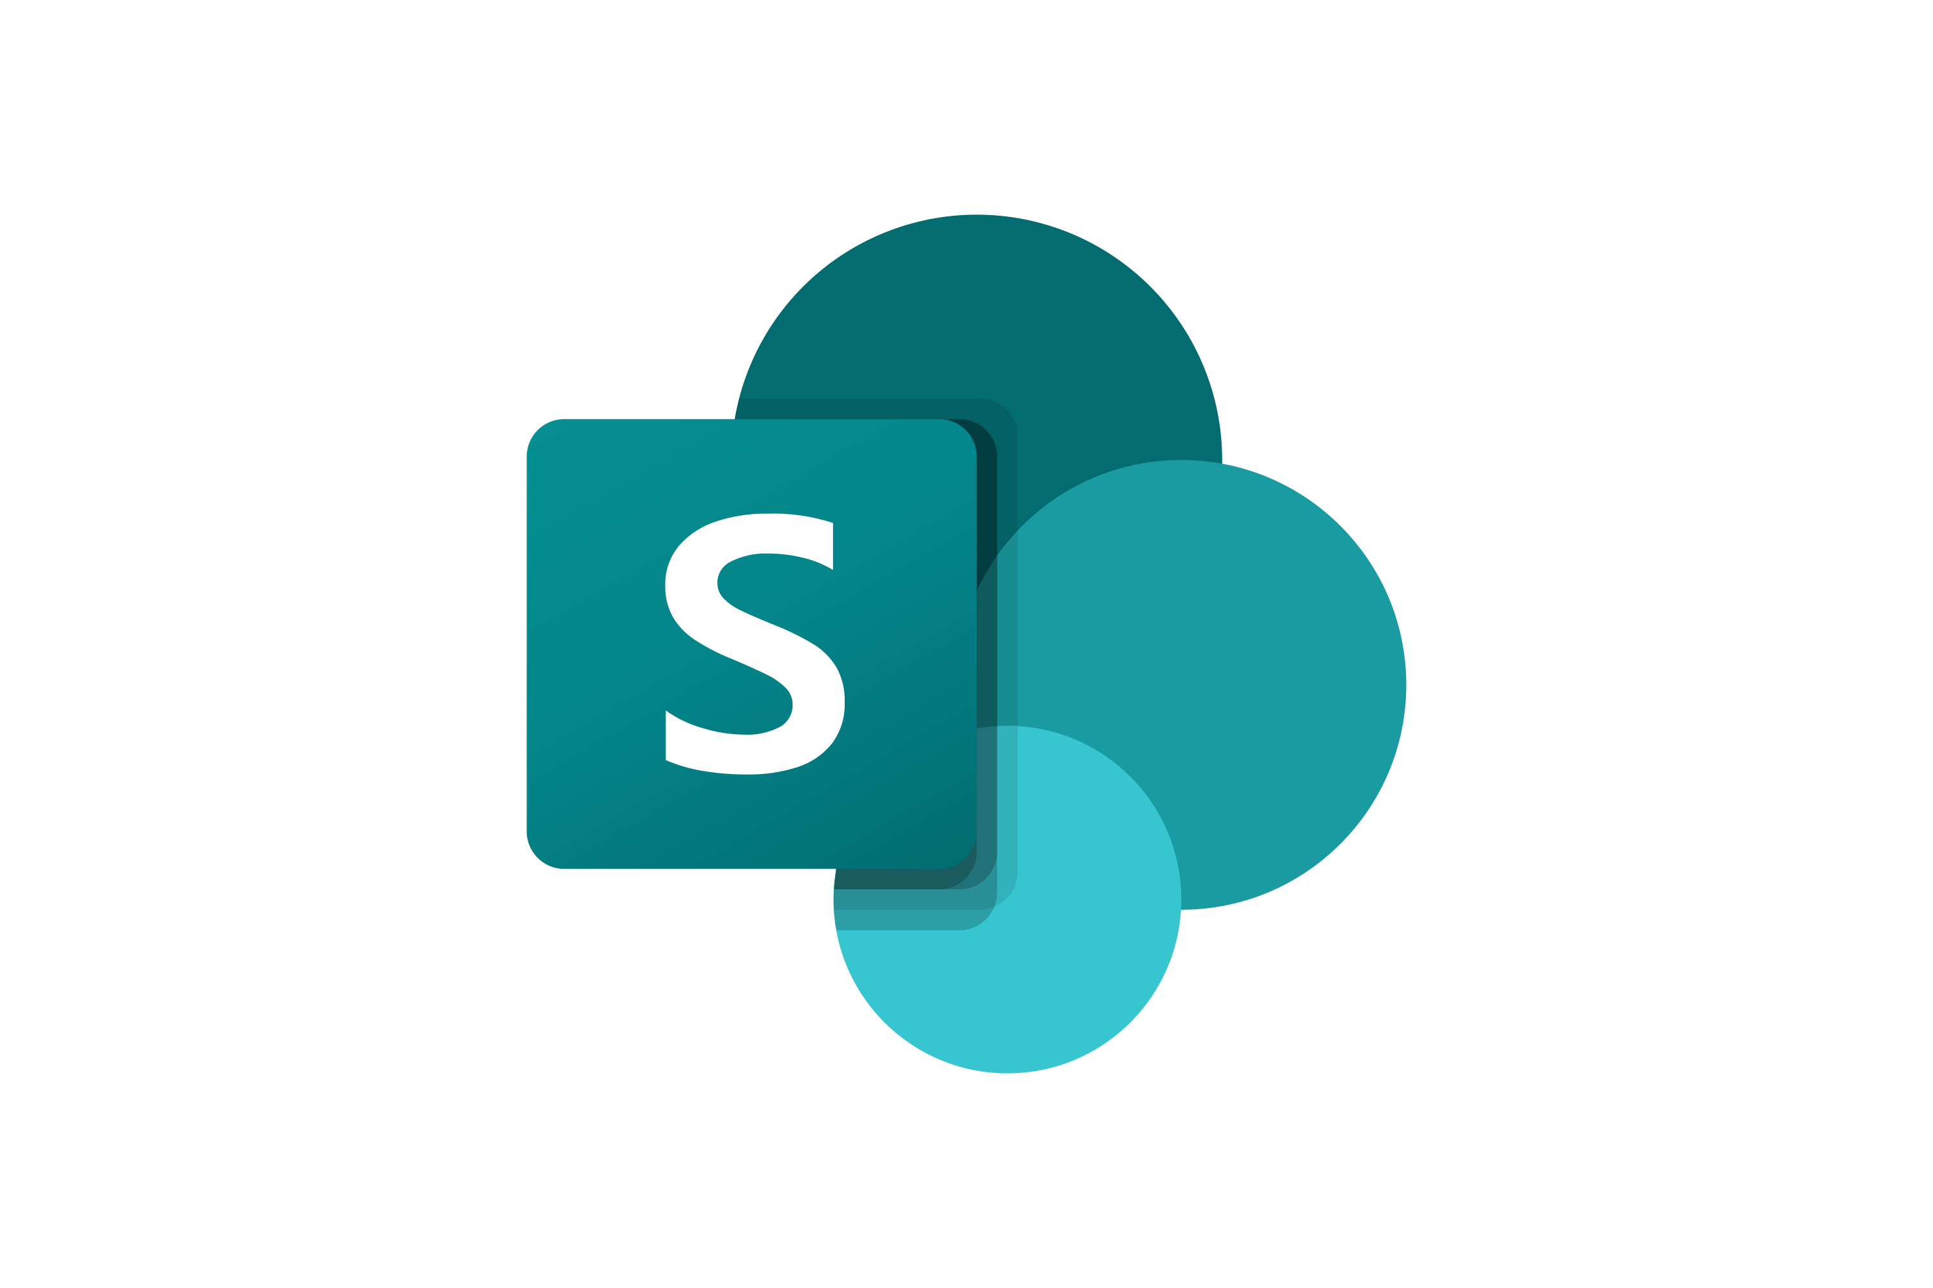


Recommended “Golden Path” Architecture
3P agents
BYO resources
Azure AI Foundry
Standard setup
Cosmos DB
Thread storage
Observability
Key vault
Connections
Built-in AI tools
Agents
Models
Azure Storage
File storage
File search
Code interpreter
Bot Service
Channels
Azure AI Search
File search index
AI tool resources
Azure AI Search
Grounding with Bing Search
Microsoft Agent Framework
Multi-agent orchestrator
Logic Apps
Azure Functions
Containers
(Azure Container Apps, etc)
Fabric
SharePoint
External APIs
OpenAPI specs
MCP servers
A2A Servers

Slide 79
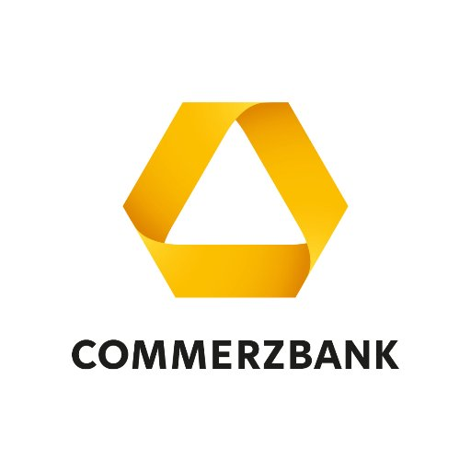




Customers are already using Microsoft Agent Framework

Slide 80
Get started with Agent Framework today
Watch the sessions on-demand
aka.ms/AgentFramework/AIShow
aka.ms/AgentFramework/OpenAtMicrosoft
Read the GA announcement blog:
aka.ms/AgentFramework/PuPr
Get started with the Agent Framework: aka.ms/AgentFramework
Learn more about Agent Framework on Microsoft Learn: aka.ms/AgentFramework/Docs
https://github.com/orgs/microsoft-foundry/discussions/331
https://devblogs.microsoft.com/agent-framework/microsoft-agent-framework-version-1-0/
https://devblogs.microsoft.com/foundry/introducing-microsoft-agent-framework-the-open-source-engine-for-agentic-ai-apps/
https://learn.microsoft.com/agent-framework/user-guide/workflows/visualization
Notes:
Thank you for joining us today! Here are the rest of the Azure OpenAI Service breakout sessions and demos that are going on this week at Ignite. We hope you will join us to learn more about Azure OpenAI Service during these other exciting sessions.

Slide 81
But most downstream processes are still brittle and require meaningful human involvement
Before AI Agents
Employees waste time structuring data
RPA breaks whenever UI is updated or changed
Automation cannot self-heal or handle novel cases
Nearly all automation today starts with form over data which is slow and error prone.
Teams must constantly monitor existing RPA scripts to ensure they do not break.
Complex logic is needed to handle unexpected edge cases within automation systems.

Slide 82
With AI Agents, you can make your automation more resilient while removing the drudgery from work
After AI Agents
Employees waste time structuring data
RPA breaks as soon as the UI updates or changes
Automation cannot self-heal or handle novel cases
LLMs spend little time structuring data
LLMs update RPAs if the
UI updates or changes
Tool calling LLMs can self-heal or handle novel cases
Convert the customer conversation into a JSON that looks like this…
Click on the submit button for the scheduling form
Assign technician
Transcript
Looks like the ID of the order form is submit-order, I’ll go ahead and click it now.
Update work order
Here you go!
Would you like me to submit the JSON to the API?
Alex declined because they're on leave
{
"name" : "John Clar
"issue": ”Washing m
}
Let me try again with an available technician.
Submit form
The form has been successfully submitted, is there anything else you need?
Update work order
Successfully assigned Lindsay

Slide 83
Agent systems with Agent Framework
Memory
Generate Outline
Research and Generate Sections
Compile and Generate
history of work
Section Writer Agent
(Introduction)
User Proxy Agent
Coordinator
Agent
LLM
User Proxy Agent
conversation
Section Writer Agent
(Section 1)
Writer
Agent
conversation
Editor
Agent
Service
Agent
LLM
Retrieval
Agent
LLM
Analytics
Agent
SLM
Coding
Agent
SLM
Outline
Agent
Section Writer Agent
(Section 2)
Critic
Agent
input
output
query
data
data
Section Writer
Agent
(Conclusion)
Web Service
Search
databases
Subprocess
docs
docker
Agent Orchestration
LLM-driven orchestration
Creative reasoning and decision-making
Ex: Propose 2 Instagram marketing campaigns including assets that would leverage the top 2 recent trends in our past quarter US Sales to boost our mailing list user base and predict the impact of each campaign
Workflow Orchestration
Business logic-driven orchestration
Mix of business processes and agents
Ex: Execution the Deep Research process to generate a document outline, write and refine section and synthesize into final document

Slide 84
Multi-Agent Orchestration Patterns
Sequential
Concurrent
Handoff
Group Chat
Magentic
Workflow Process
worker
reviewer
Notes:
Concurrent Orchestration
The concurrent orchestration works in the following steps:
The orchestration is invoked with a task.
The orchestration broadcasts the task to all actors.
Actors start processing the task and send the result to the result collector.
The result collector collects the results and when the expected number of results are received, it calls a callback function to signal the end of the orchestration.
Sequential Orchestration
The sequential orchestration works in the following steps:
The orchestration is invoked with a task.
The orchestration sends the task to the first actor.
The first actor processes the task and sends the result to the next actor.
The last actor processes the result and sends the result to the result collector.
The result collector calls a callback function to signal the end of the orchestration.
Handoff Orchestration
The handoff orchestration works in the following steps:
The orchestration is invoked with a task.
The orchestration sends the task to all actors.
The orchestration sends a "request to speak" message to the first actor.
The first actor processes the task, broadcast the conversation context, and decides if it needs to delegate the task to another actor.
If the first actor decides to delegate the task, it sends a "request to speak" message to the other actor.
The other actor processes the task and decides if it needs to delegate the task to another actor.
The process continues until the last actor decides that the task is complete and calls a callback function to signal the end of the orchestration.
Group Chat Orchestration
The group chat orchestration works in the following steps:
The orchestration is invoked with a task.
The orchestration sends the task to all actors.
The orchestration sends the task to the group manager, which will trigger the group chat manager to start the orchestration.
The group manager decides the state of the conversation from one of the following:
Request User Input -> calls a callback function and waits for user input.
Terminate
Next Actor
If the conversation needs to continue, the group manager picks the next actor and sends a "request to speak" message to the actor.
The actor processes the request and broadcasts the response to the internal topic.
All other actors receive the response and add the response to their conversation context.
The group manager receives the response and continues from step 4.
If the conversation is over, the group manager retrieves a result and calls a callback function to signal the end of the orchestration.
The group chat manager is responsible for managing the conversation flow. It will have the following responsibilities:
class GroupChatManager(KernelBaseModel, ABC): """A group chat manager that manages the flow of a group chat.""" user_input_func: Callable[[ChatHistory], Awaitable[str]] | None = None @abstractmethod async def should_request_user_input(self, chat_history: ChatHistory) -> bool: raise NotImplementedError @abstractmethod async def should_terminate(self, chat_history: ChatHistory) -> bool: raise NotImplementedError @abstractmethod async def select_next_agent(self, chat_history: ChatHistory, participant_descriptions: dict[str, str]) -> str: raise NotImplementedError @abstractmethod async def filter_results(self, chat_history: ChatHistory) -> ChatMessageContent: raise NotImplementedError
Magentic One Orchestration
Magentic one is a group chat-like orchestration with a special group manager. Refer to the Magentic One blog or paper for more details.

Slide 85
Sequential pattern
The sequential orchestration pattern chains AI agents in a predefined, linear order. Each agent processes the output from the previous agent in the sequence, which creates a pipeline of specialized transformations.
The sequential orchestration pattern solves problems that require step-by-step processing, where each stage builds on the previous stage.
Notes:
Concurrent Orchestration
The concurrent orchestration works in the following steps:
The orchestration is invoked with a task.
The orchestration broadcasts the task to all actors.
Actors start processing the task and send the result to the result collector.
The result collector collects the results and when the expected number of results are received, it calls a callback function to signal the end of the orchestration.
Sequential Orchestration
The sequential orchestration works in the following steps:
The orchestration is invoked with a task.
The orchestration sends the task to the first actor.
The first actor processes the task and sends the result to the next actor.
The last actor processes the result and sends the result to the result collector.
The result collector calls a callback function to signal the end of the orchestration.
Handoff Orchestration
The handoff orchestration works in the following steps:
The orchestration is invoked with a task.
The orchestration sends the task to all actors.
The orchestration sends a "request to speak" message to the first actor.
The first actor processes the task, broadcast the conversation context, and decides if it needs to delegate the task to another actor.
If the first actor decides to delegate the task, it sends a "request to speak" message to the other actor.
The other actor processes the task and decides if it needs to delegate the task to another actor.
The process continues until the last actor decides that the task is complete and calls a callback function to signal the end of the orchestration.
Group Chat Orchestration
The group chat orchestration works in the following steps:
The orchestration is invoked with a task.
The orchestration sends the task to all actors.
The orchestration sends the task to the group manager, which will trigger the group chat manager to start the orchestration.
The group manager decides the state of the conversation from one of the following:
Request User Input -> calls a callback function and waits for user input.
Terminate
Next Actor
If the conversation needs to continue, the group manager picks the next actor and sends a "request to speak" message to the actor.
The actor processes the request and broadcasts the response to the internal topic.
All other actors receive the response and add the response to their conversation context.
The group manager receives the response and continues from step 4.
If the conversation is over, the group manager retrieves a result and calls a callback function to signal the end of the orchestration.
The group chat manager is responsible for managing the conversation flow. It will have the following responsibilities:
class GroupChatManager(KernelBaseModel, ABC): """A group chat manager that manages the flow of a group chat.""" user_input_func: Callable[[ChatHistory], Awaitable[str]] | None = None @abstractmethod async def should_request_user_input(self, chat_history: ChatHistory) -> bool: raise NotImplementedError @abstractmethod async def should_terminate(self, chat_history: ChatHistory) -> bool: raise NotImplementedError @abstractmethod async def select_next_agent(self, chat_history: ChatHistory, participant_descriptions: dict[str, str]) -> str: raise NotImplementedError @abstractmethod async def filter_results(self, chat_history: ChatHistory) -> ChatMessageContent: raise NotImplementedError
Magentic One Orchestration
Magentic one is a group chat-like orchestration with a special group manager. Refer to the Magentic One blog or paper for more details.

Slide 86
Concurrent pattern
The concurrent orchestration pattern runs multiple AI agents simultaneously on the same task. This approach allows each agent to provide independent analysis or processing from its unique perspective or specialization.
This pattern addresses scenarios where you need diverse insights or approaches to the same problem.
Notes:
Concurrent Orchestration
The concurrent orchestration works in the following steps:
The orchestration is invoked with a task.
The orchestration broadcasts the task to all actors.
Actors start processing the task and send the result to the result collector.
The result collector collects the results and when the expected number of results are received, it calls a callback function to signal the end of the orchestration.
Sequential Orchestration
The sequential orchestration works in the following steps:
The orchestration is invoked with a task.
The orchestration sends the task to the first actor.
The first actor processes the task and sends the result to the next actor.
The last actor processes the result and sends the result to the result collector.
The result collector calls a callback function to signal the end of the orchestration.
Handoff Orchestration
The handoff orchestration works in the following steps:
The orchestration is invoked with a task.
The orchestration sends the task to all actors.
The orchestration sends a "request to speak" message to the first actor.
The first actor processes the task, broadcast the conversation context, and decides if it needs to delegate the task to another actor.
If the first actor decides to delegate the task, it sends a "request to speak" message to the other actor.
The other actor processes the task and decides if it needs to delegate the task to another actor.
The process continues until the last actor decides that the task is complete and calls a callback function to signal the end of the orchestration.
Group Chat Orchestration
The group chat orchestration works in the following steps:
The orchestration is invoked with a task.
The orchestration sends the task to all actors.
The orchestration sends the task to the group manager, which will trigger the group chat manager to start the orchestration.
The group manager decides the state of the conversation from one of the following:
Request User Input -> calls a callback function and waits for user input.
Terminate
Next Actor
If the conversation needs to continue, the group manager picks the next actor and sends a "request to speak" message to the actor.
The actor processes the request and broadcasts the response to the internal topic.
All other actors receive the response and add the response to their conversation context.
The group manager receives the response and continues from step 4.
If the conversation is over, the group manager retrieves a result and calls a callback function to signal the end of the orchestration.
The group chat manager is responsible for managing the conversation flow. It will have the following responsibilities:
class GroupChatManager(KernelBaseModel, ABC): """A group chat manager that manages the flow of a group chat.""" user_input_func: Callable[[ChatHistory], Awaitable[str]] | None = None @abstractmethod async def should_request_user_input(self, chat_history: ChatHistory) -> bool: raise NotImplementedError @abstractmethod async def should_terminate(self, chat_history: ChatHistory) -> bool: raise NotImplementedError @abstractmethod async def select_next_agent(self, chat_history: ChatHistory, participant_descriptions: dict[str, str]) -> str: raise NotImplementedError @abstractmethod async def filter_results(self, chat_history: ChatHistory) -> ChatMessageContent: raise NotImplementedError
Magentic One Orchestration
Magentic one is a group chat-like orchestration with a special group manager. Refer to the Magentic One blog or paper for more details.

Slide 87
Group chat pattern
The group chat orchestration pattern enables multiple agents to solve problems, make decisions, or validate work by participating in a shared conversation thread where they collaborate through discussion.
This pattern addresses scenarios that are best accomplished through group discussion to reach decisions.
Notes:
Concurrent Orchestration
The concurrent orchestration works in the following steps:
The orchestration is invoked with a task.
The orchestration broadcasts the task to all actors.
Actors start processing the task and send the result to the result collector.
The result collector collects the results and when the expected number of results are received, it calls a callback function to signal the end of the orchestration.
Sequential Orchestration
The sequential orchestration works in the following steps:
The orchestration is invoked with a task.
The orchestration sends the task to the first actor.
The first actor processes the task and sends the result to the next actor.
The last actor processes the result and sends the result to the result collector.
The result collector calls a callback function to signal the end of the orchestration.
Handoff Orchestration
The handoff orchestration works in the following steps:
The orchestration is invoked with a task.
The orchestration sends the task to all actors.
The orchestration sends a "request to speak" message to the first actor.
The first actor processes the task, broadcast the conversation context, and decides if it needs to delegate the task to another actor.
If the first actor decides to delegate the task, it sends a "request to speak" message to the other actor.
The other actor processes the task and decides if it needs to delegate the task to another actor.
The process continues until the last actor decides that the task is complete and calls a callback function to signal the end of the orchestration.
Group Chat Orchestration
The group chat orchestration works in the following steps:
The orchestration is invoked with a task.
The orchestration sends the task to all actors.
The orchestration sends the task to the group manager, which will trigger the group chat manager to start the orchestration.
The group manager decides the state of the conversation from one of the following:
Request User Input -> calls a callback function and waits for user input.
Terminate
Next Actor
If the conversation needs to continue, the group manager picks the next actor and sends a "request to speak" message to the actor.
The actor processes the request and broadcasts the response to the internal topic.
All other actors receive the response and add the response to their conversation context.
The group manager receives the response and continues from step 4.
If the conversation is over, the group manager retrieves a result and calls a callback function to signal the end of the orchestration.
The group chat manager is responsible for managing the conversation flow. It will have the following responsibilities:
class GroupChatManager(KernelBaseModel, ABC): """A group chat manager that manages the flow of a group chat.""" user_input_func: Callable[[ChatHistory], Awaitable[str]] | None = None @abstractmethod async def should_request_user_input(self, chat_history: ChatHistory) -> bool: raise NotImplementedError @abstractmethod async def should_terminate(self, chat_history: ChatHistory) -> bool: raise NotImplementedError @abstractmethod async def select_next_agent(self, chat_history: ChatHistory, participant_descriptions: dict[str, str]) -> str: raise NotImplementedError @abstractmethod async def filter_results(self, chat_history: ChatHistory) -> ChatMessageContent: raise NotImplementedError
Magentic One Orchestration
Magentic one is a group chat-like orchestration with a special group manager. Refer to the Magentic One blog or paper for more details.

Slide 88
Handoff pattern
The handoff orchestration pattern enables dynamic delegation of tasks between specialized agents. Each agent can assess the task at hand and decide whether to handle it directly or transfer it to a more appropriate agent based on the context and requirements.
This pattern addresses scenarios where the optimal agent for a task isn't known upfront or where the task requirements become clear only during processing.
Notes:
Concurrent Orchestration
The concurrent orchestration works in the following steps:
The orchestration is invoked with a task.
The orchestration broadcasts the task to all actors.
Actors start processing the task and send the result to the result collector.
The result collector collects the results and when the expected number of results are received, it calls a callback function to signal the end of the orchestration.
Sequential Orchestration
The sequential orchestration works in the following steps:
The orchestration is invoked with a task.
The orchestration sends the task to the first actor.
The first actor processes the task and sends the result to the next actor.
The last actor processes the result and sends the result to the result collector.
The result collector calls a callback function to signal the end of the orchestration.
Handoff Orchestration
The handoff orchestration works in the following steps:
The orchestration is invoked with a task.
The orchestration sends the task to all actors.
The orchestration sends a "request to speak" message to the first actor.
The first actor processes the task, broadcast the conversation context, and decides if it needs to delegate the task to another actor.
If the first actor decides to delegate the task, it sends a "request to speak" message to the other actor.
The other actor processes the task and decides if it needs to delegate the task to another actor.
The process continues until the last actor decides that the task is complete and calls a callback function to signal the end of the orchestration.
Group Chat Orchestration
The group chat orchestration works in the following steps:
The orchestration is invoked with a task.
The orchestration sends the task to all actors.
The orchestration sends the task to the group manager, which will trigger the group chat manager to start the orchestration.
The group manager decides the state of the conversation from one of the following:
Request User Input -> calls a callback function and waits for user input.
Terminate
Next Actor
If the conversation needs to continue, the group manager picks the next actor and sends a "request to speak" message to the actor.
The actor processes the request and broadcasts the response to the internal topic.
All other actors receive the response and add the response to their conversation context.
The group manager receives the response and continues from step 4.
If the conversation is over, the group manager retrieves a result and calls a callback function to signal the end of the orchestration.
The group chat manager is responsible for managing the conversation flow. It will have the following responsibilities:
class GroupChatManager(KernelBaseModel, ABC): """A group chat manager that manages the flow of a group chat.""" user_input_func: Callable[[ChatHistory], Awaitable[str]] | None = None @abstractmethod async def should_request_user_input(self, chat_history: ChatHistory) -> bool: raise NotImplementedError @abstractmethod async def should_terminate(self, chat_history: ChatHistory) -> bool: raise NotImplementedError @abstractmethod async def select_next_agent(self, chat_history: ChatHistory, participant_descriptions: dict[str, str]) -> str: raise NotImplementedError @abstractmethod async def filter_results(self, chat_history: ChatHistory) -> ChatMessageContent: raise NotImplementedError
Magentic One Orchestration
Magentic one is a group chat-like orchestration with a special group manager. Refer to the Magentic One blog or paper for more details.

Slide 89
Magentic pattern
The magentic orchestration pattern is designed for open-ended and complex problems that don't have a predetermined plan of approach.
The manager agent communicates directly with specialized agents to gather information as it builds and refines the task ledger
Notes:
Concurrent Orchestration
The concurrent orchestration works in the following steps:
The orchestration is invoked with a task.
The orchestration broadcasts the task to all actors.
Actors start processing the task and send the result to the result collector.
The result collector collects the results and when the expected number of results are received, it calls a callback function to signal the end of the orchestration.
Sequential Orchestration
The sequential orchestration works in the following steps:
The orchestration is invoked with a task.
The orchestration sends the task to the first actor.
The first actor processes the task and sends the result to the next actor.
The last actor processes the result and sends the result to the result collector.
The result collector calls a callback function to signal the end of the orchestration.
Handoff Orchestration
The handoff orchestration works in the following steps:
The orchestration is invoked with a task.
The orchestration sends the task to all actors.
The orchestration sends a "request to speak" message to the first actor.
The first actor processes the task, broadcast the conversation context, and decides if it needs to delegate the task to another actor.
If the first actor decides to delegate the task, it sends a "request to speak" message to the other actor.
The other actor processes the task and decides if it needs to delegate the task to another actor.
The process continues until the last actor decides that the task is complete and calls a callback function to signal the end of the orchestration.
Group Chat Orchestration
The group chat orchestration works in the following steps:
The orchestration is invoked with a task.
The orchestration sends the task to all actors.
The orchestration sends the task to the group manager, which will trigger the group chat manager to start the orchestration.
The group manager decides the state of the conversation from one of the following:
Request User Input -> calls a callback function and waits for user input.
Terminate
Next Actor
If the conversation needs to continue, the group manager picks the next actor and sends a "request to speak" message to the actor.
The actor processes the request and broadcasts the response to the internal topic.
All other actors receive the response and add the response to their conversation context.
The group manager receives the response and continues from step 4.
If the conversation is over, the group manager retrieves a result and calls a callback function to signal the end of the orchestration.
The group chat manager is responsible for managing the conversation flow. It will have the following responsibilities:
class GroupChatManager(KernelBaseModel, ABC): """A group chat manager that manages the flow of a group chat.""" user_input_func: Callable[[ChatHistory], Awaitable[str]] | None = None @abstractmethod async def should_request_user_input(self, chat_history: ChatHistory) -> bool: raise NotImplementedError @abstractmethod async def should_terminate(self, chat_history: ChatHistory) -> bool: raise NotImplementedError @abstractmethod async def select_next_agent(self, chat_history: ChatHistory, participant_descriptions: dict[str, str]) -> str: raise NotImplementedError @abstractmethod async def filter_results(self, chat_history: ChatHistory) -> ChatMessageContent: raise NotImplementedError
Magentic One Orchestration
Magentic one is a group chat-like orchestration with a special group manager. Refer to the Magentic One blog or paper for more details.

